Slide 1
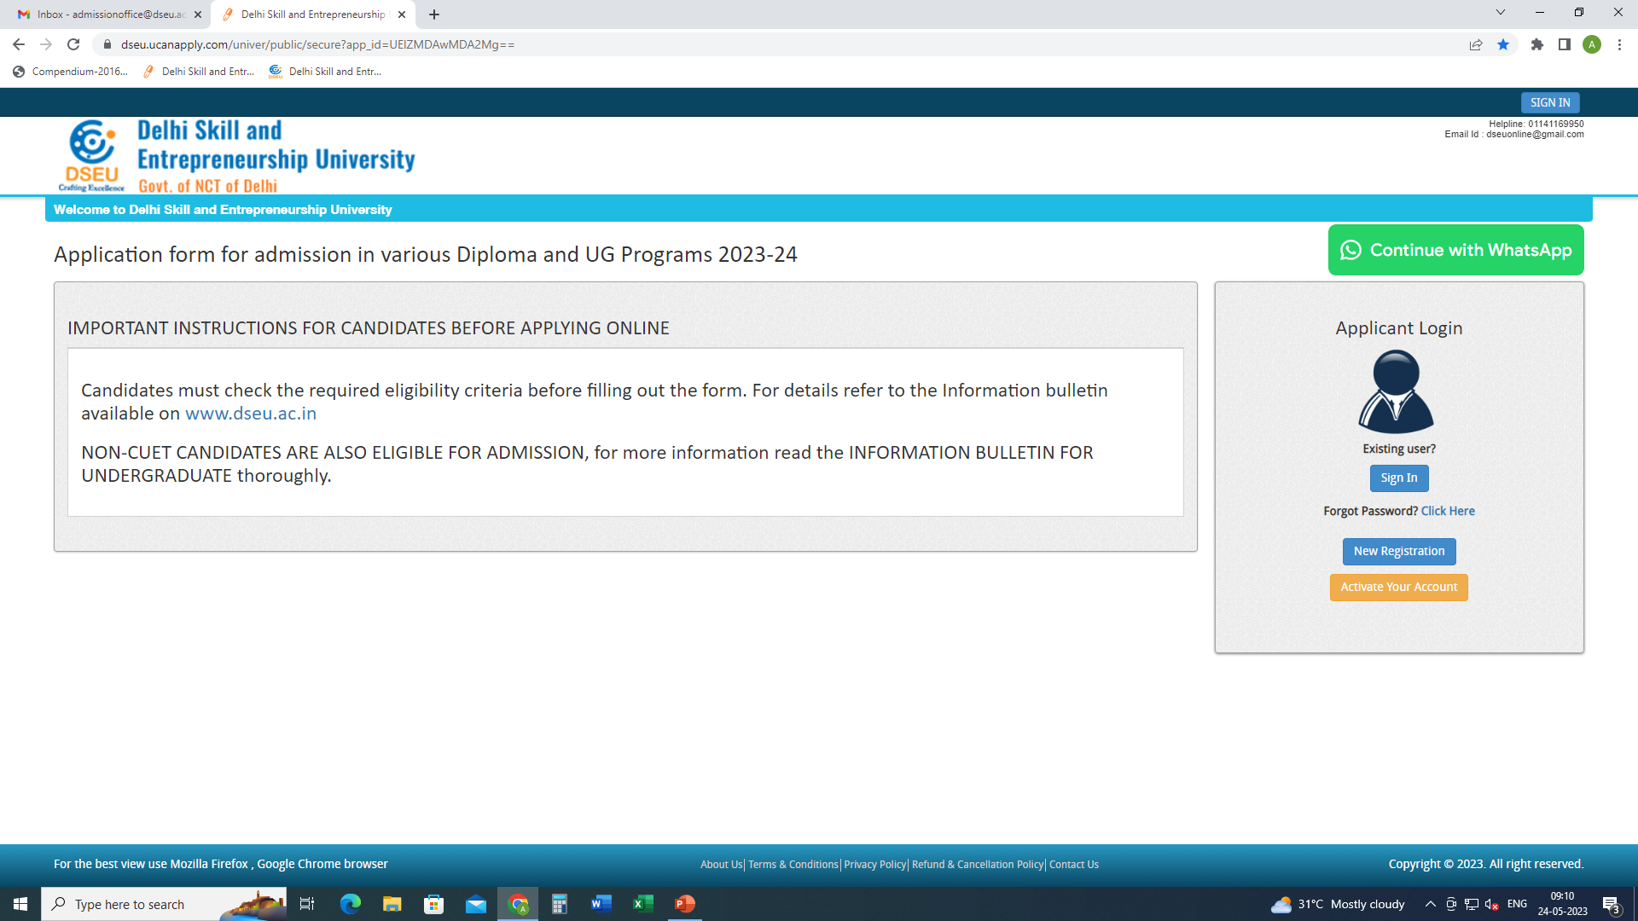
Step 1- Registration.
Enter Details.
Confirm
Step 2
Activate account.

Slide 2
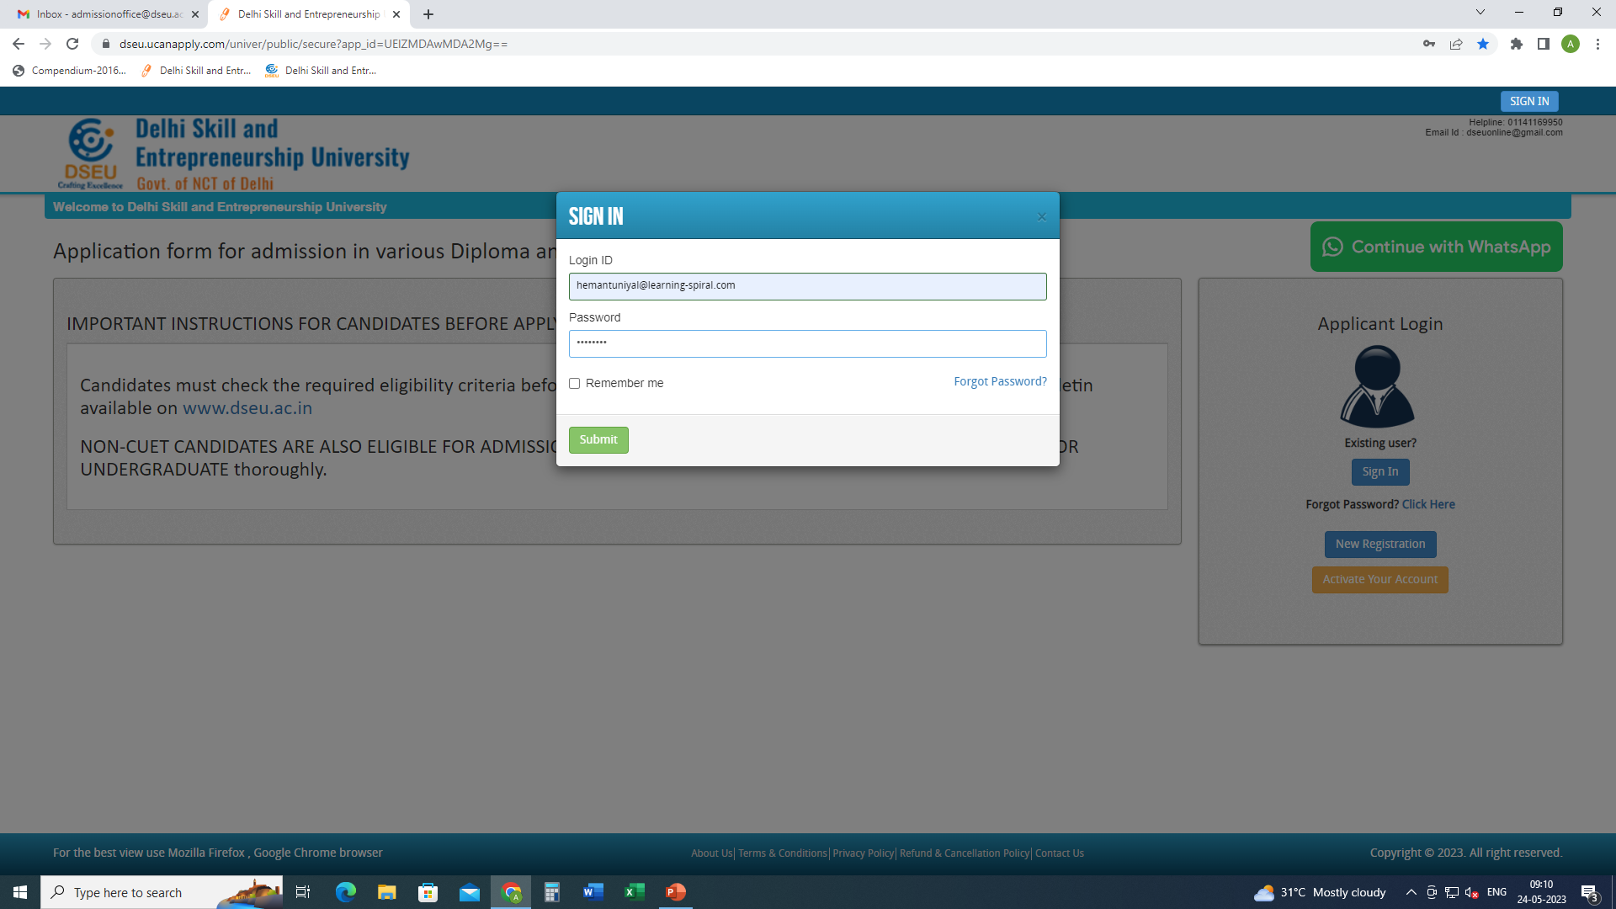
Step 3- Sign In.

Slide 3
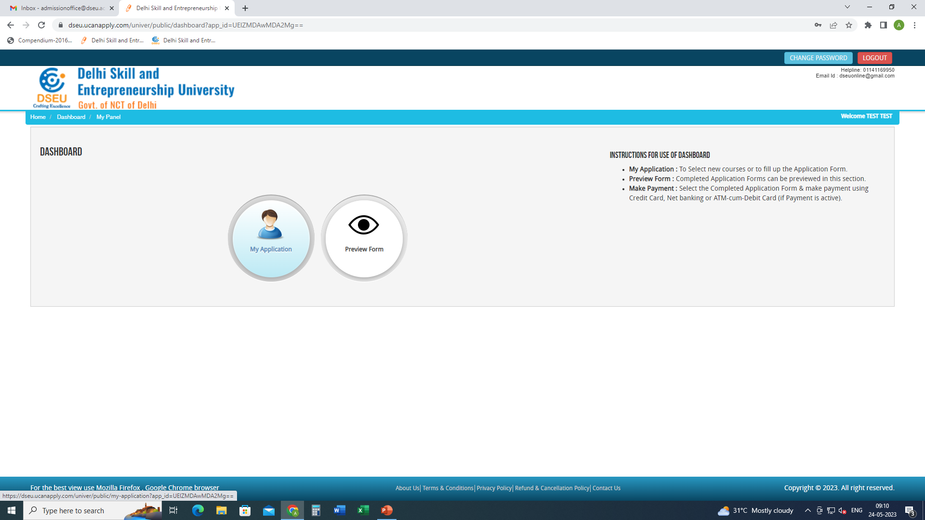
Step 4- My application

Slide 4
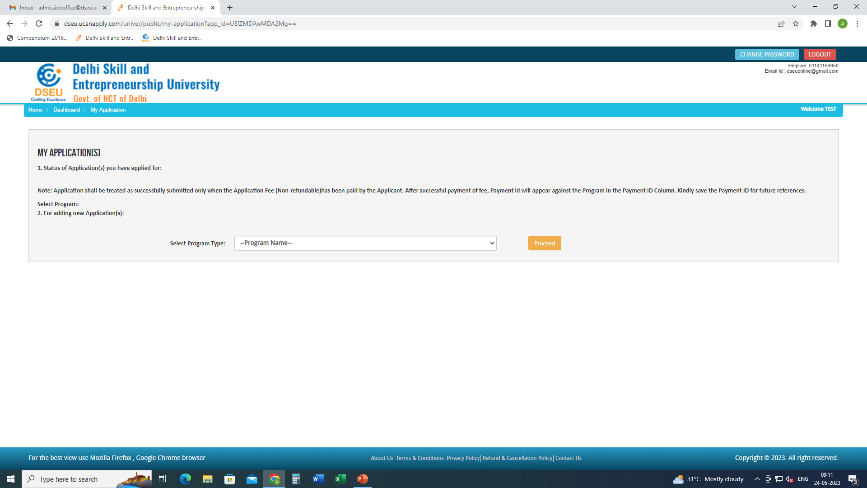
Select Program

Slide 5
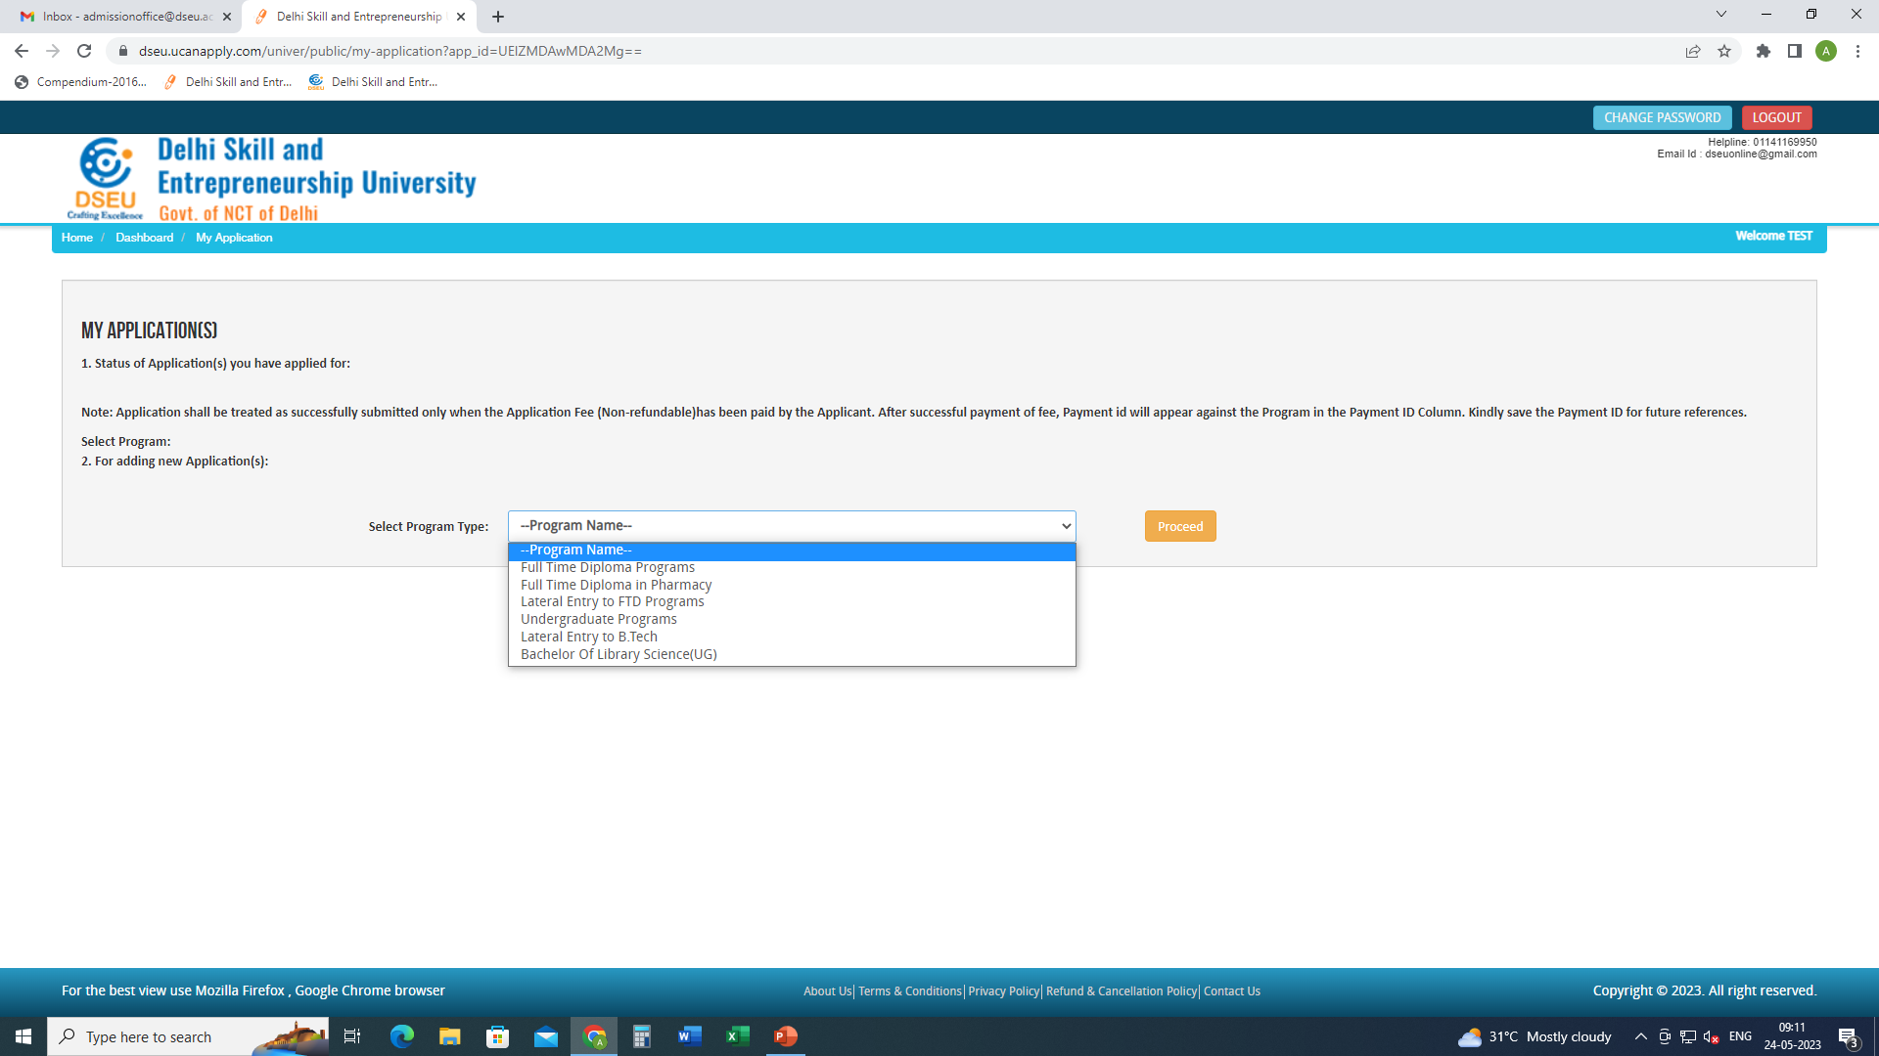

Slide 6
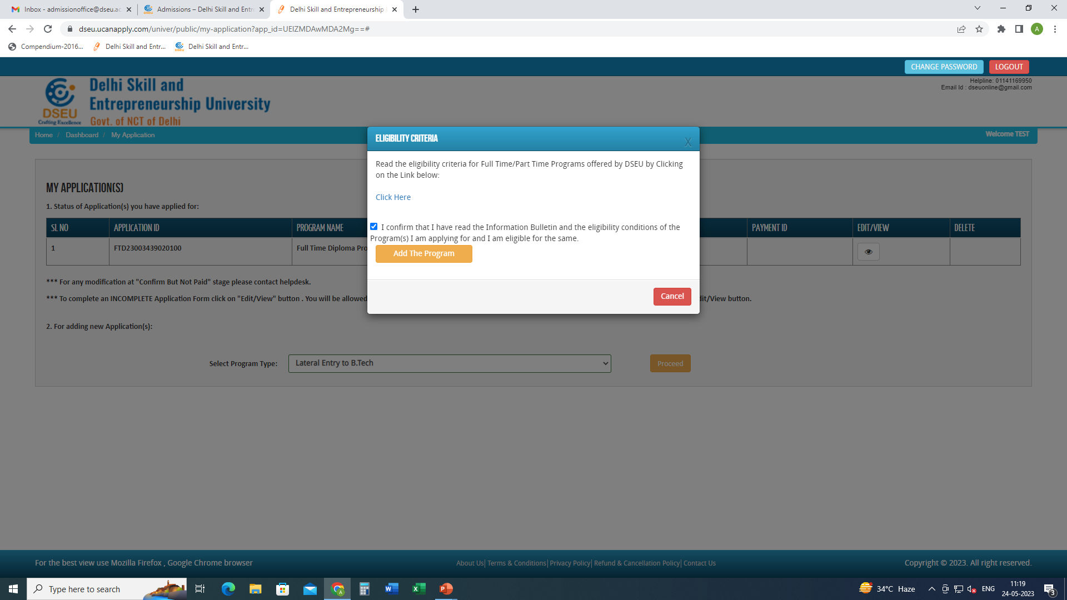
Click to check the eligibility conditions for the program selected.
Check the box
And
Add the program

Slide 7
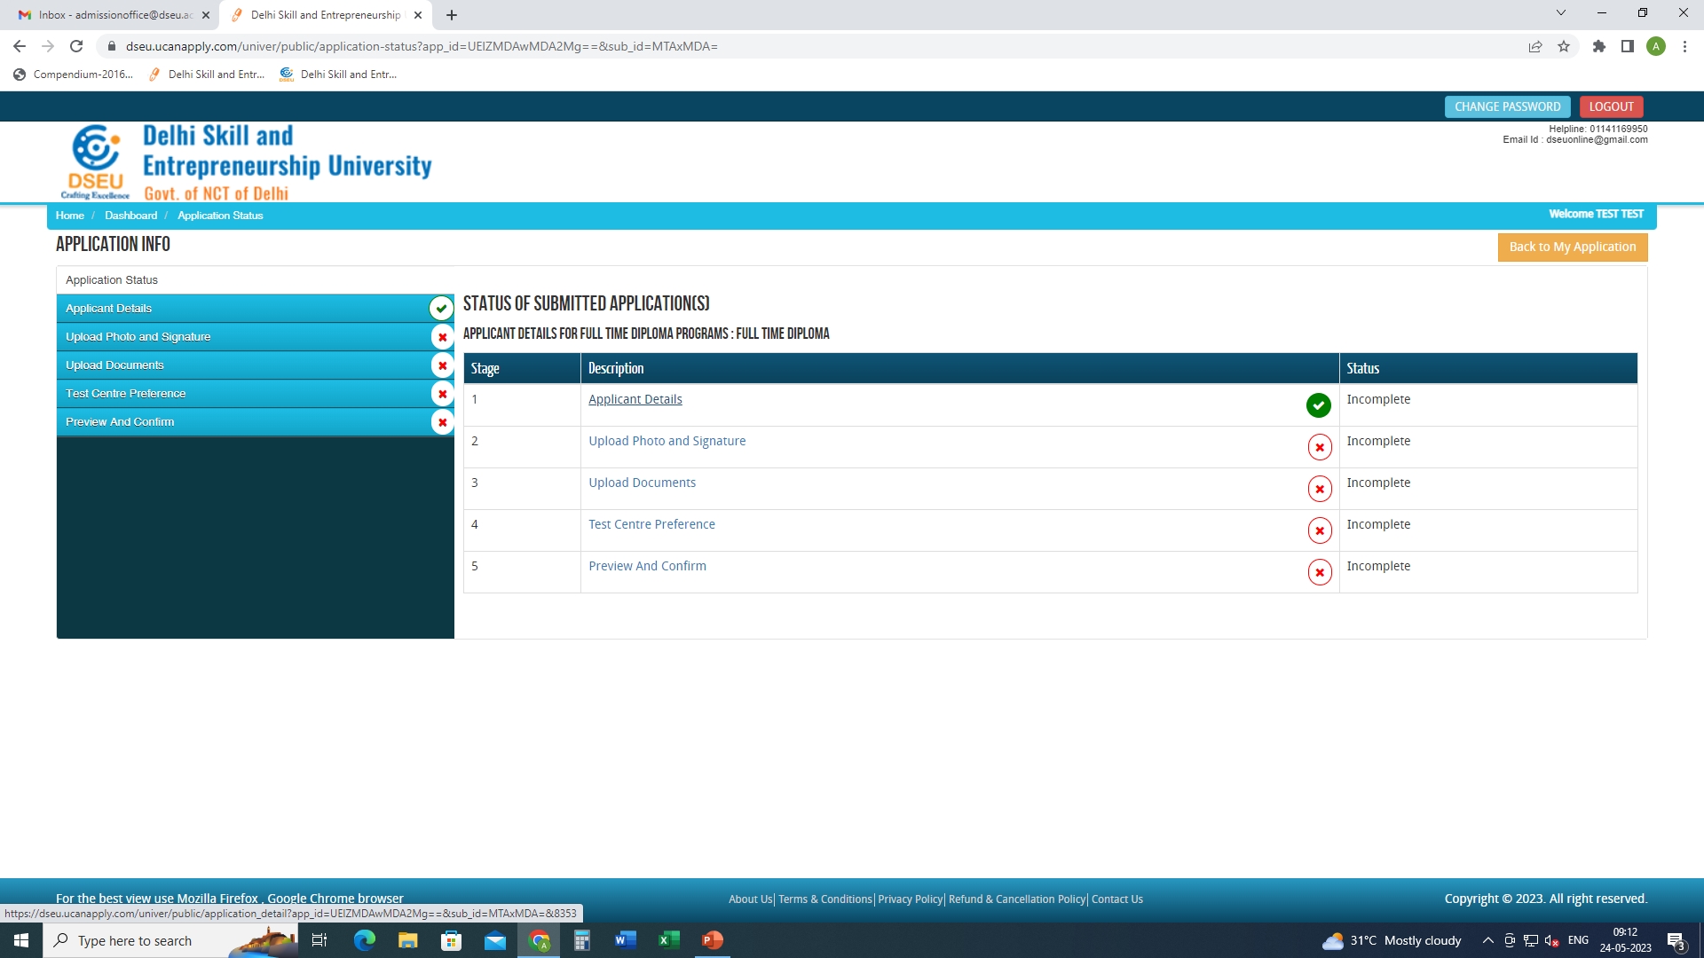
Click applicant details and fill the required information.

Slide 8
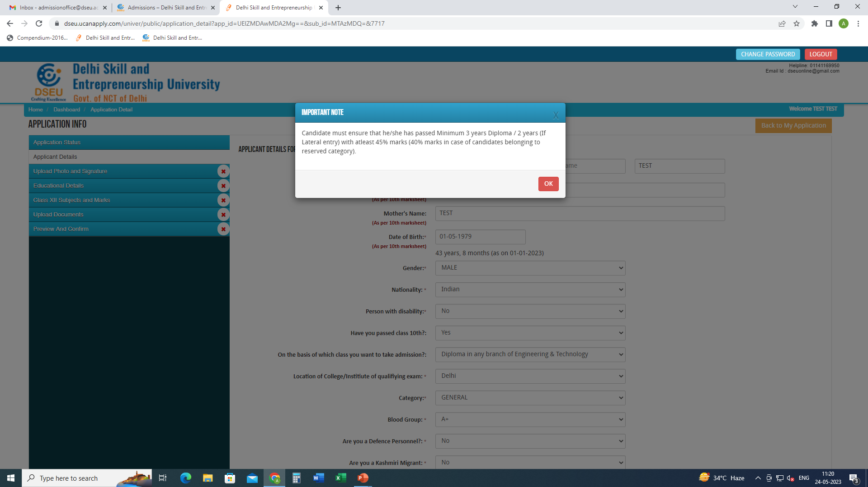
When click on Applicant Details pop up will show up.
Fill the required information

Slide 9
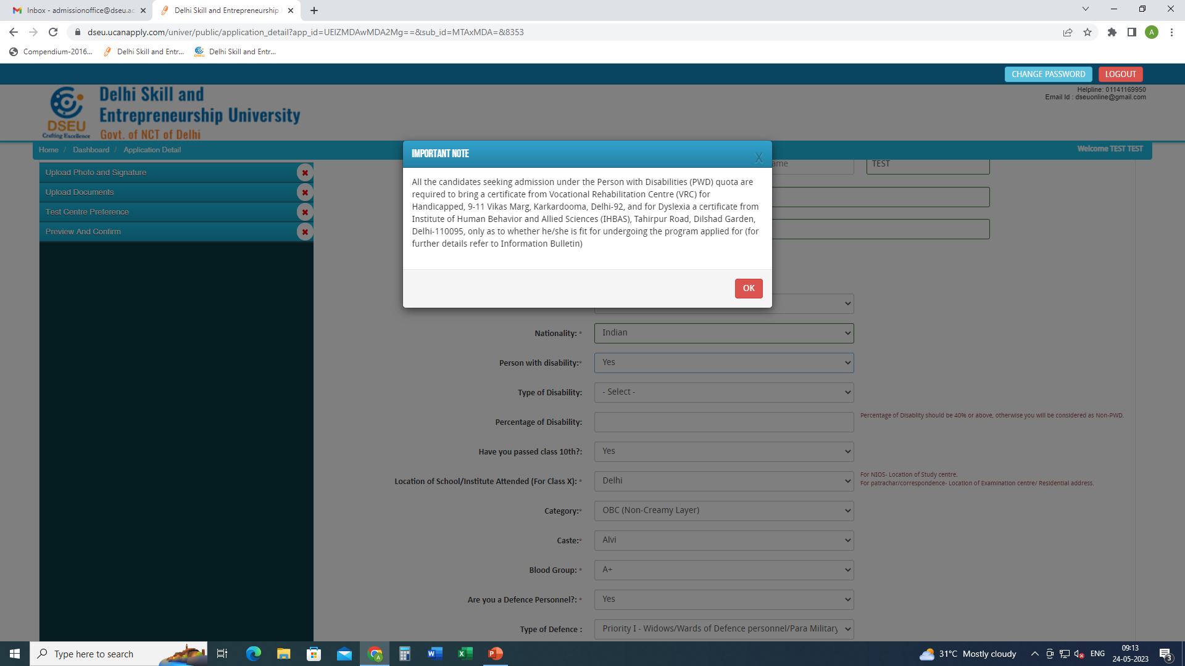
If selected ‘Yes’ in Person with Disability

Slide 10
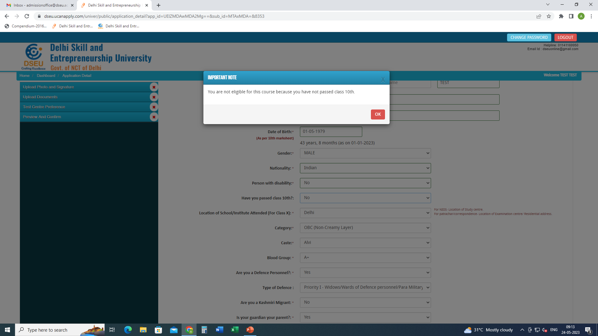
If selected ‘NO’ in Have you passed class 10th

Slide 11
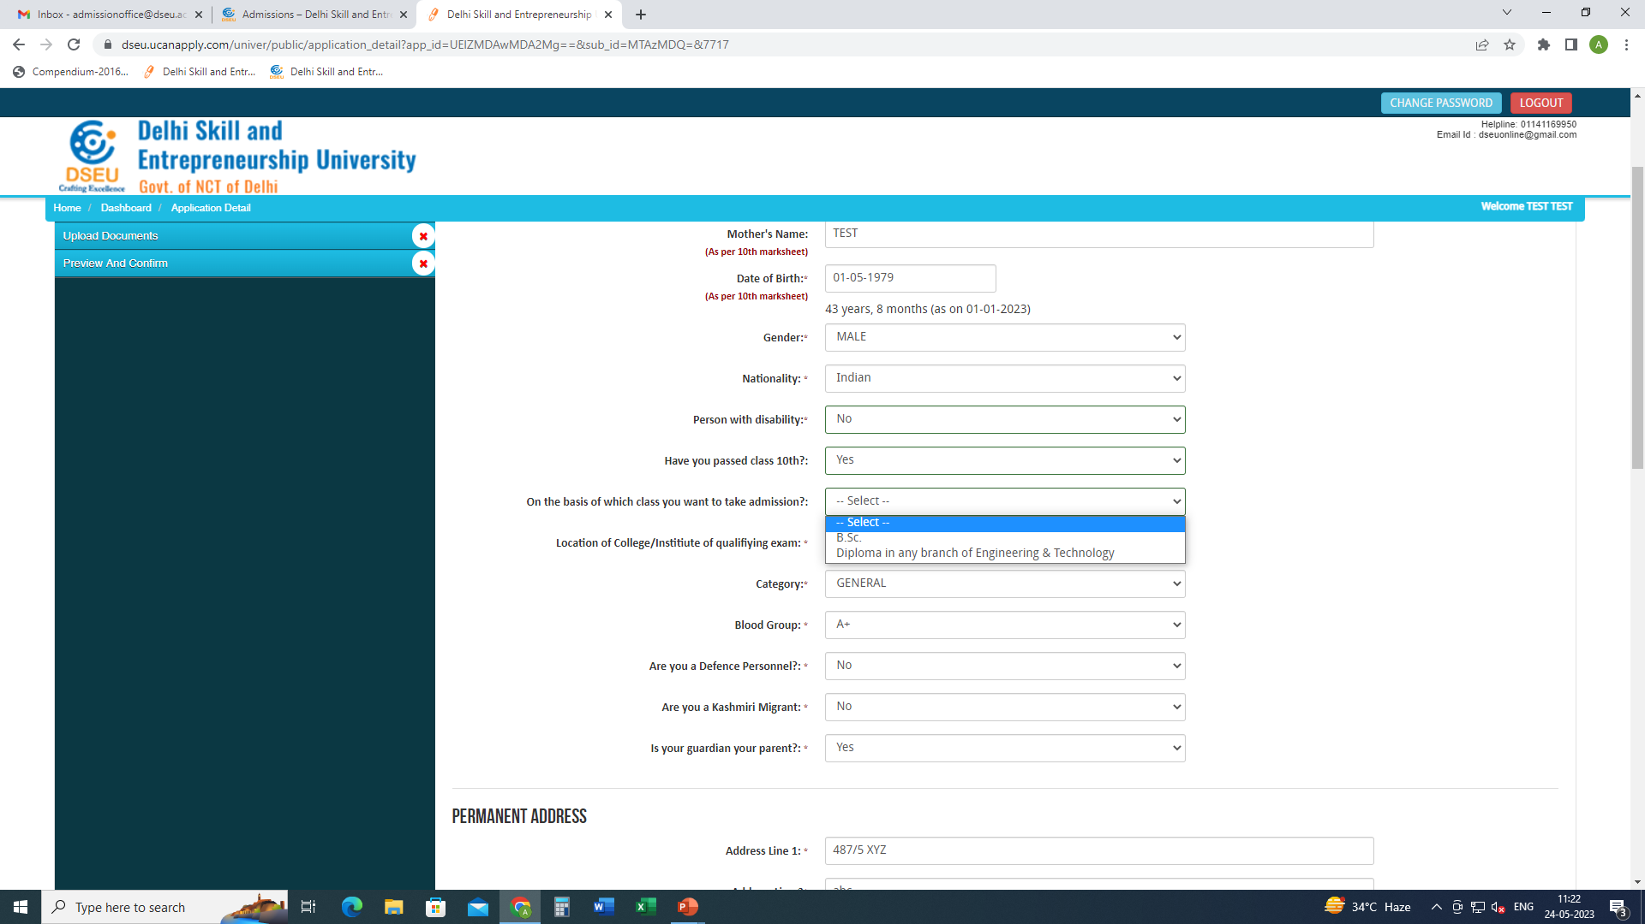
Select the qualifying examination.

Slide 12
If selected BSc with Mathematics at 12th pop up will come.

Slide 13
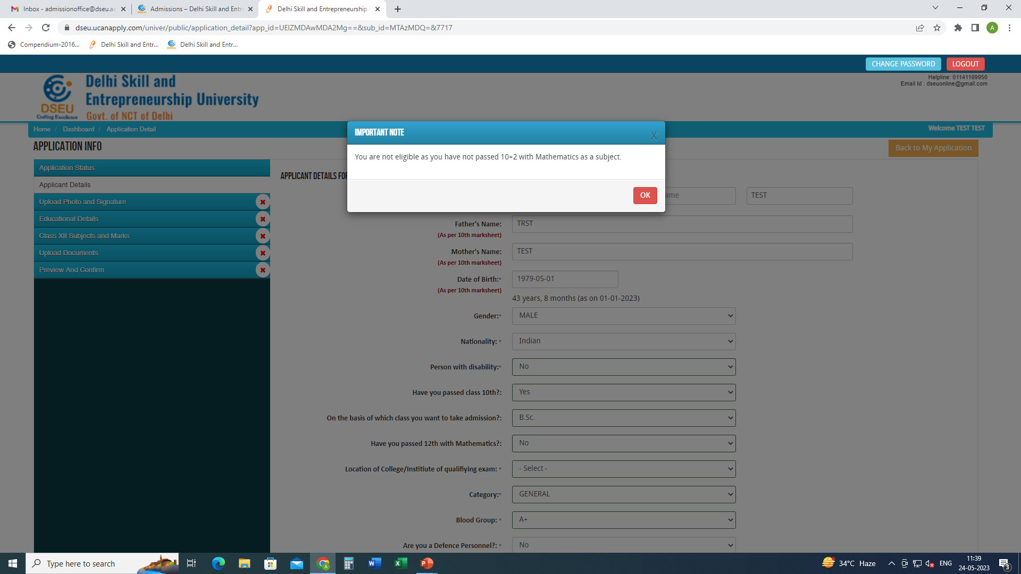
If selected BSc with
NO Mathematics at 12th pop up will come.

Slide 14
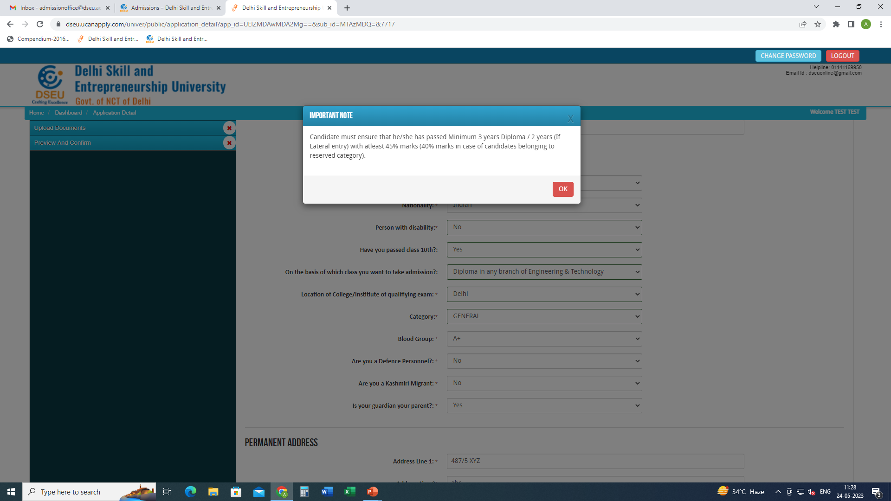
If selected “dilploma in any branch of Engineering and Tech” and give the location of college/institute of qualifying exam, whether delhi or outside delhi

Slide 15
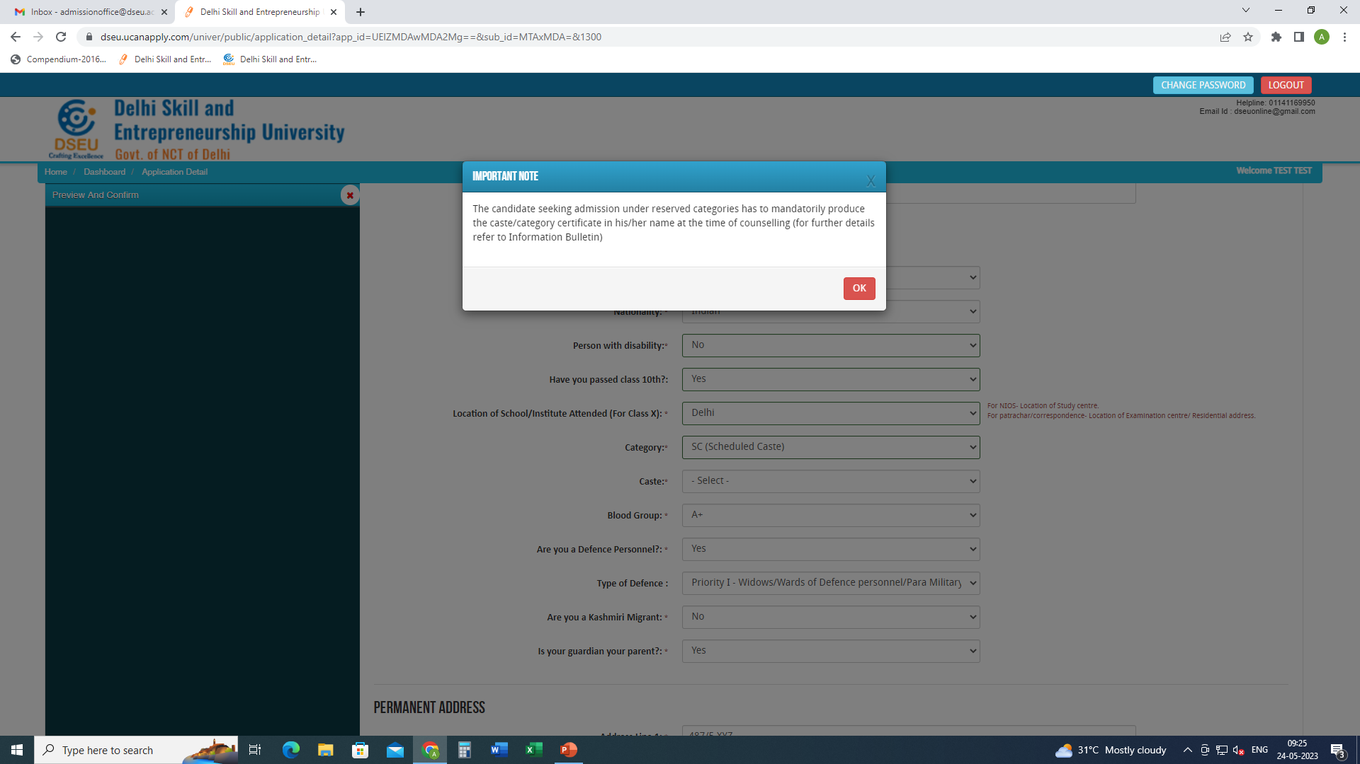
For Delhi SC candidate
Choose caste from the Drop Down

Slide 16
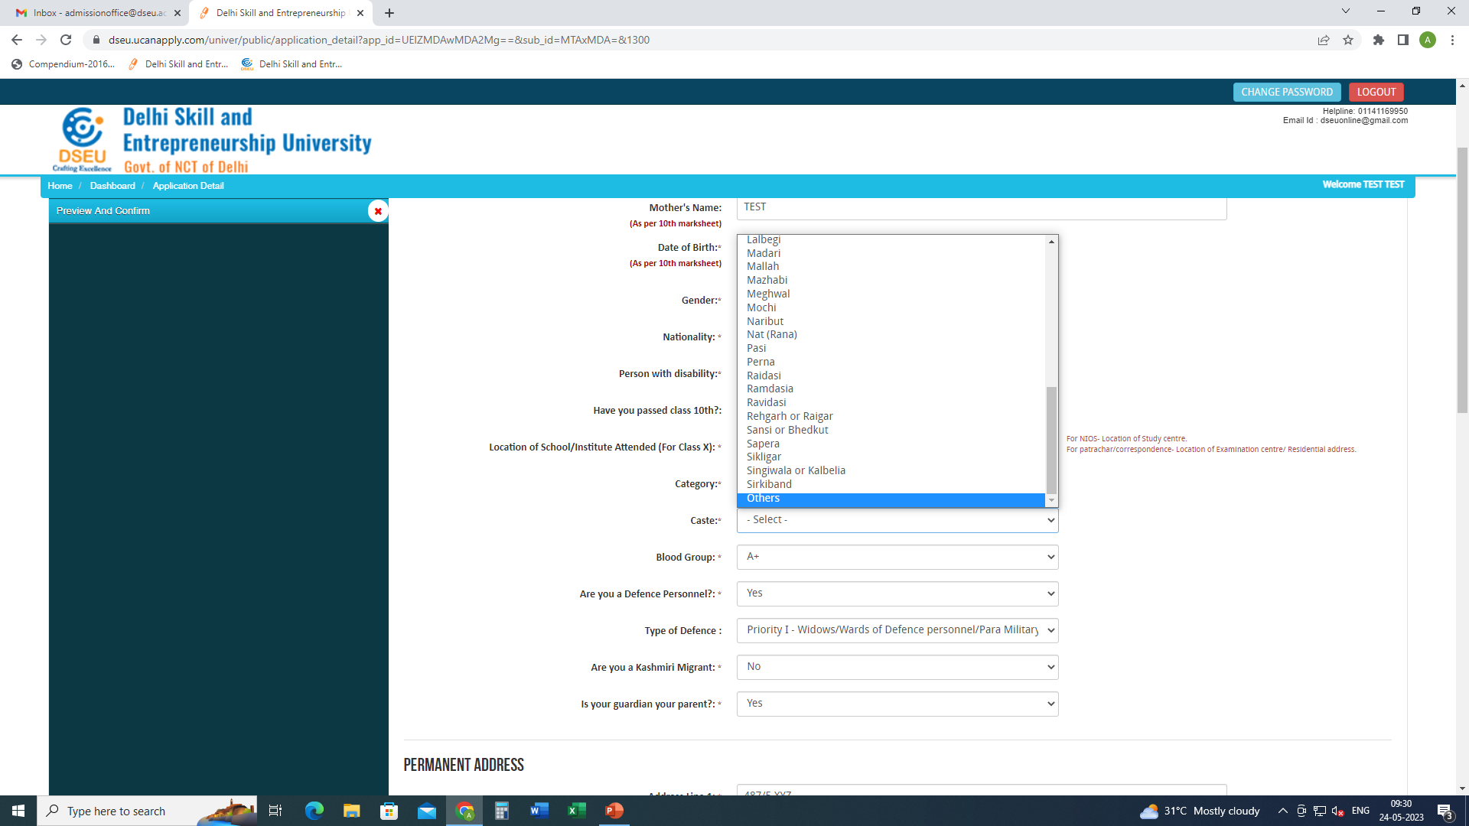
If caste is selected as others

Slide 17
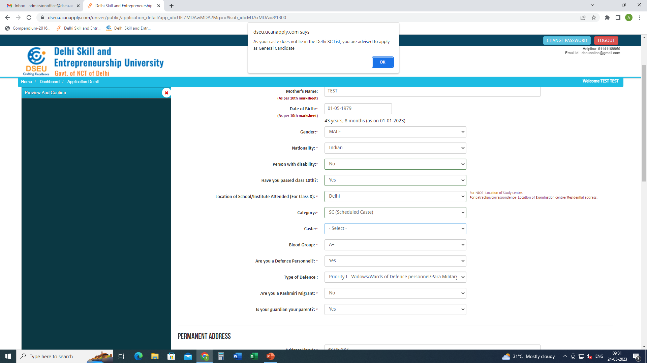
Pop up will ask the candidate to apply as General Candidate

Slide 18
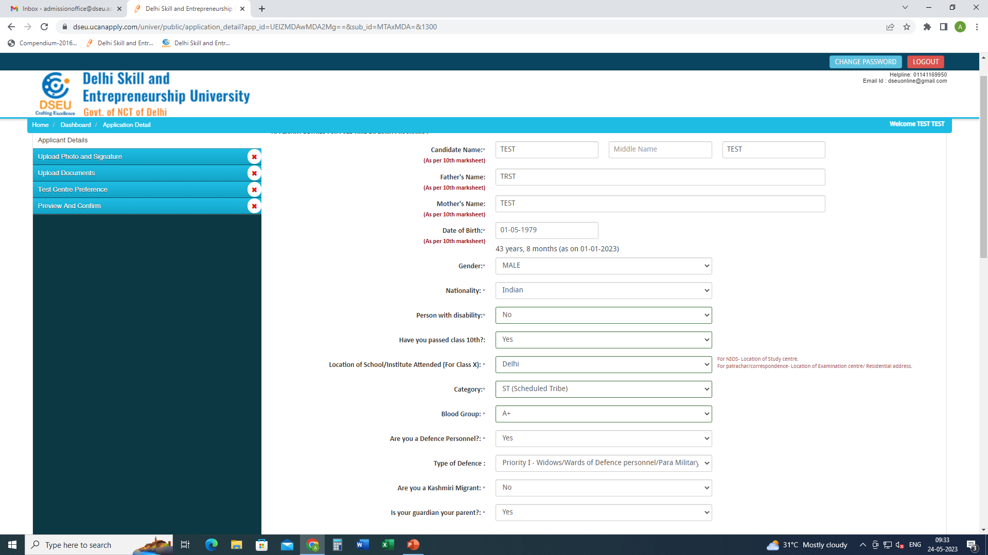
For ST Candidate there will be no pop up and the system will allow him to proceed further.

Slide 19
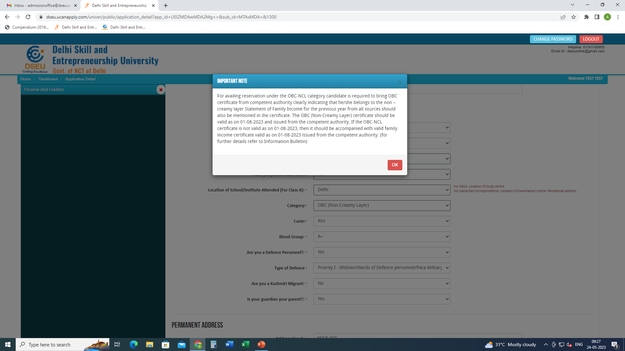
For Delhi- OBC Candidate
Choose caste from the Drop Down

Slide 20
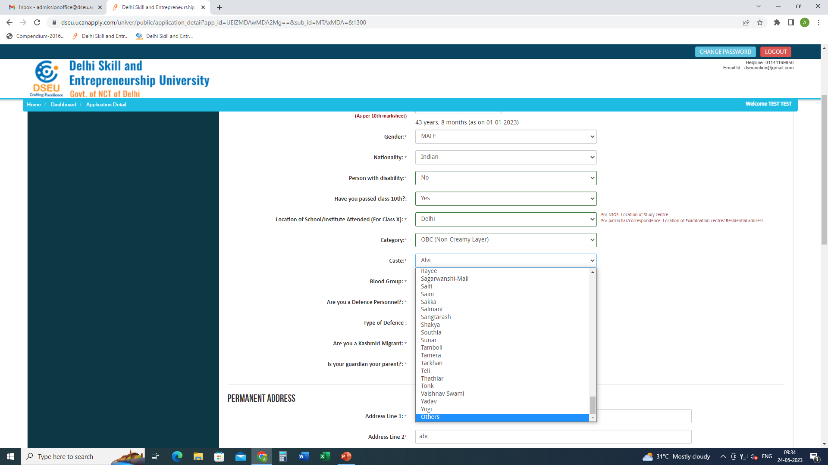
If caste is selected as others then

Slide 21
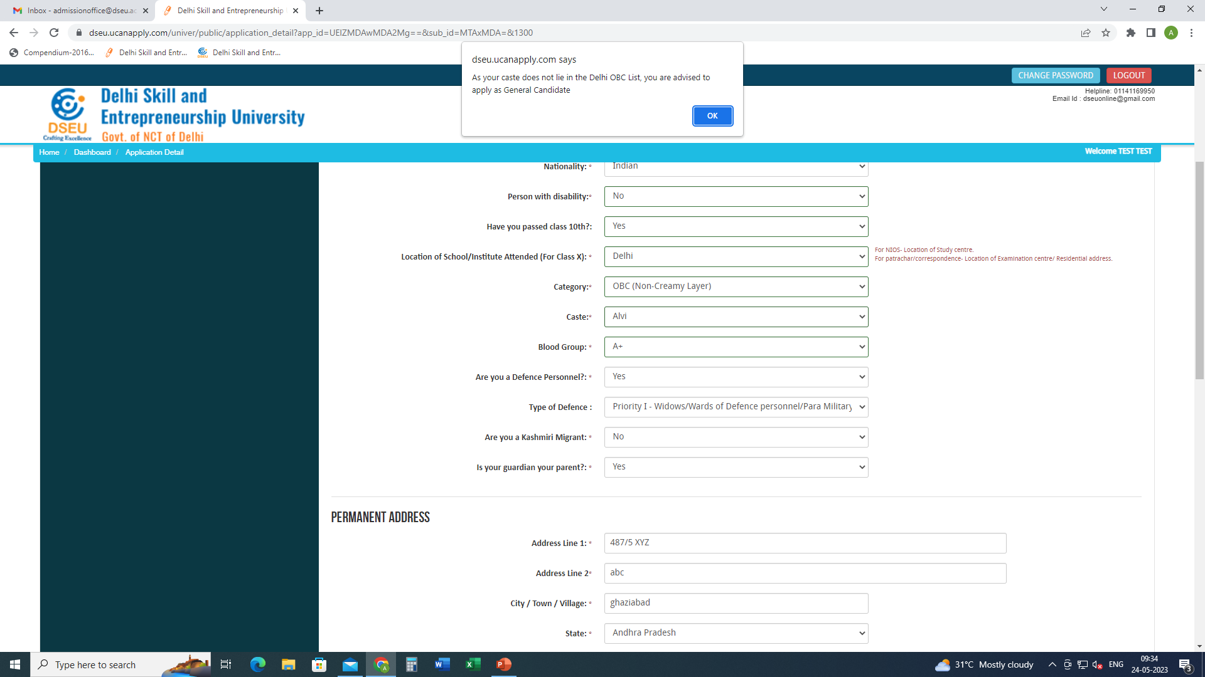
Pop up will ask the candidate to apply as General Candidate
Fill other required information
Then Save and Proceed.

Slide 22
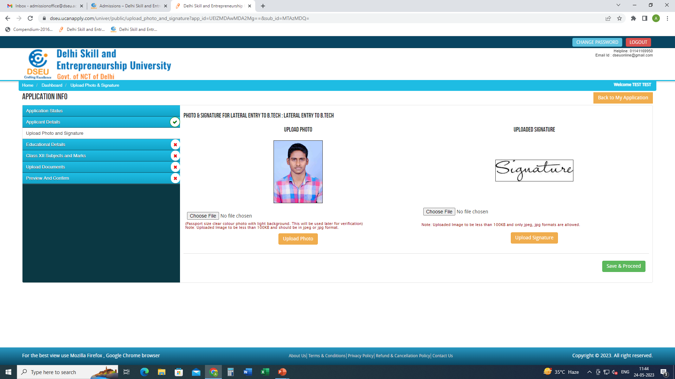
Upload photo and signature
Save and proceed

Slide 23
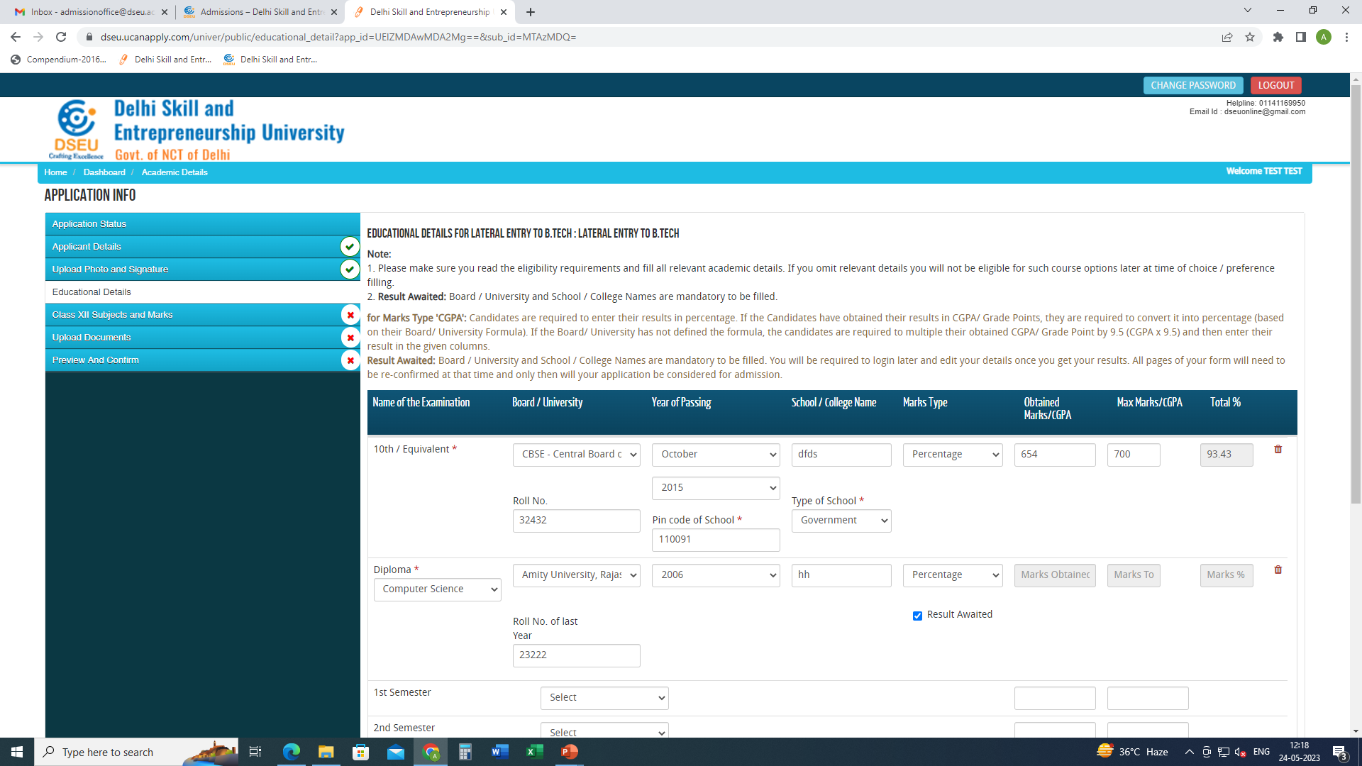
Fill Your educational details
Save and Proceed

Slide 24
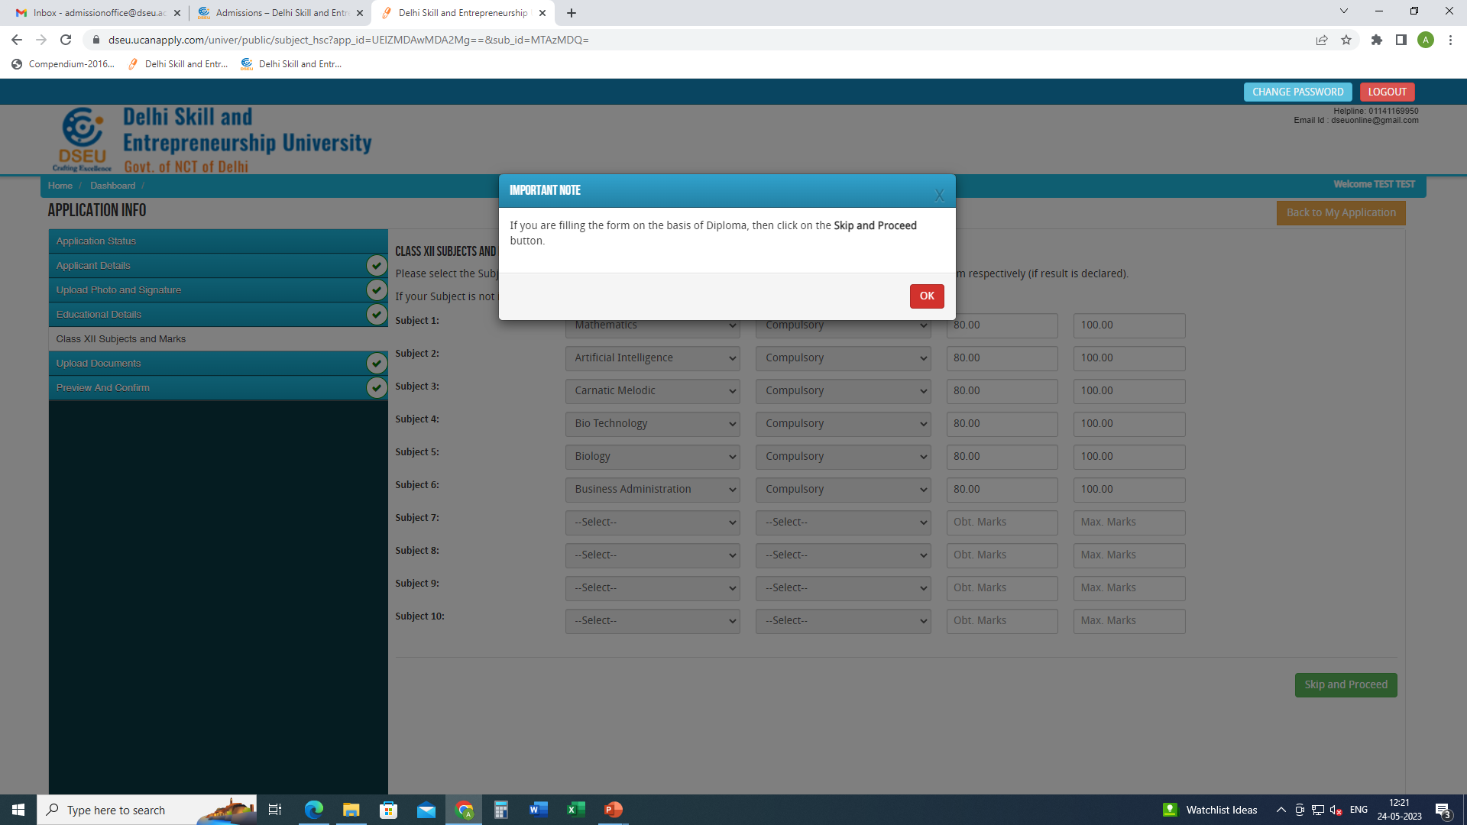
if you are filling form on the basis of Diploma, then skip and proceed.
If you are filling form on the Basis of BSC, then you will be required to fill these details mandatorily

Slide 25
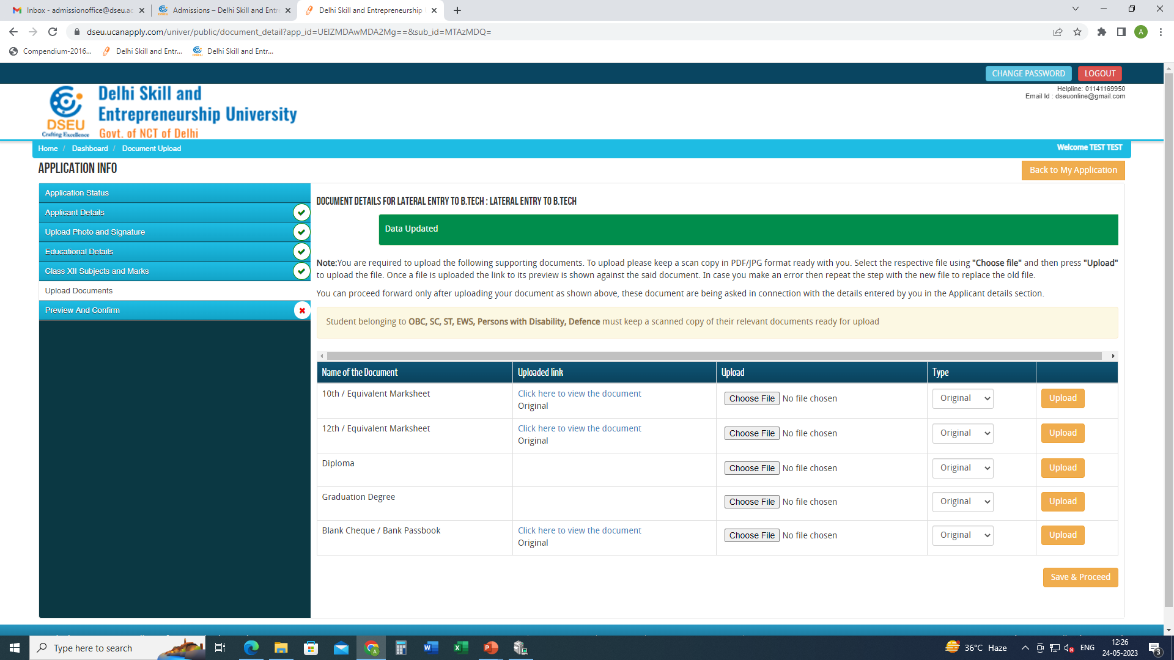
Upload the required documents
Save and Proceed

Slide 26
preview and confirm( check details carefully) -pay registration fee -print final application form for future reference.

