Slide 1
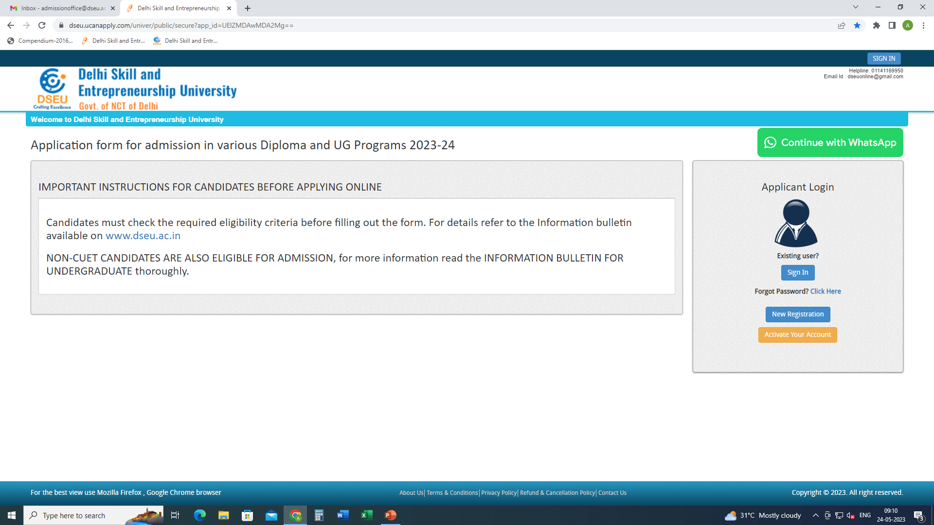
Step 1- Registration.
Enter Details.
Confirm
Step 2
Activate account.

Slide 2
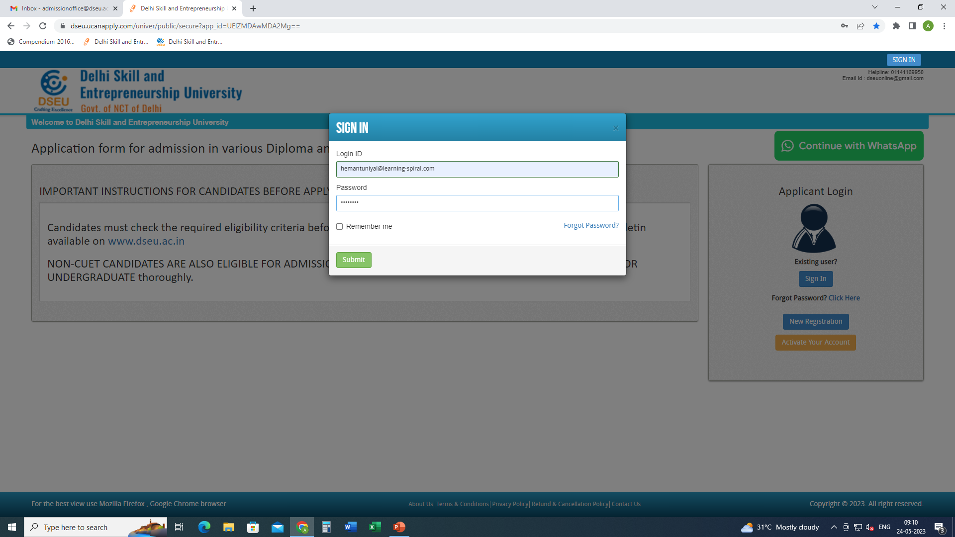
Step 3- Sign In.

Slide 3
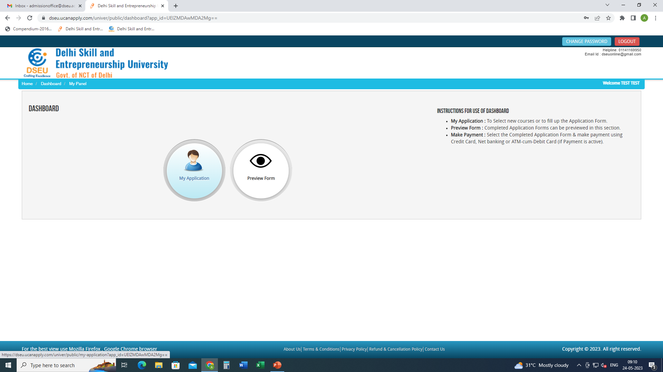
Step 4- My application

Slide 4
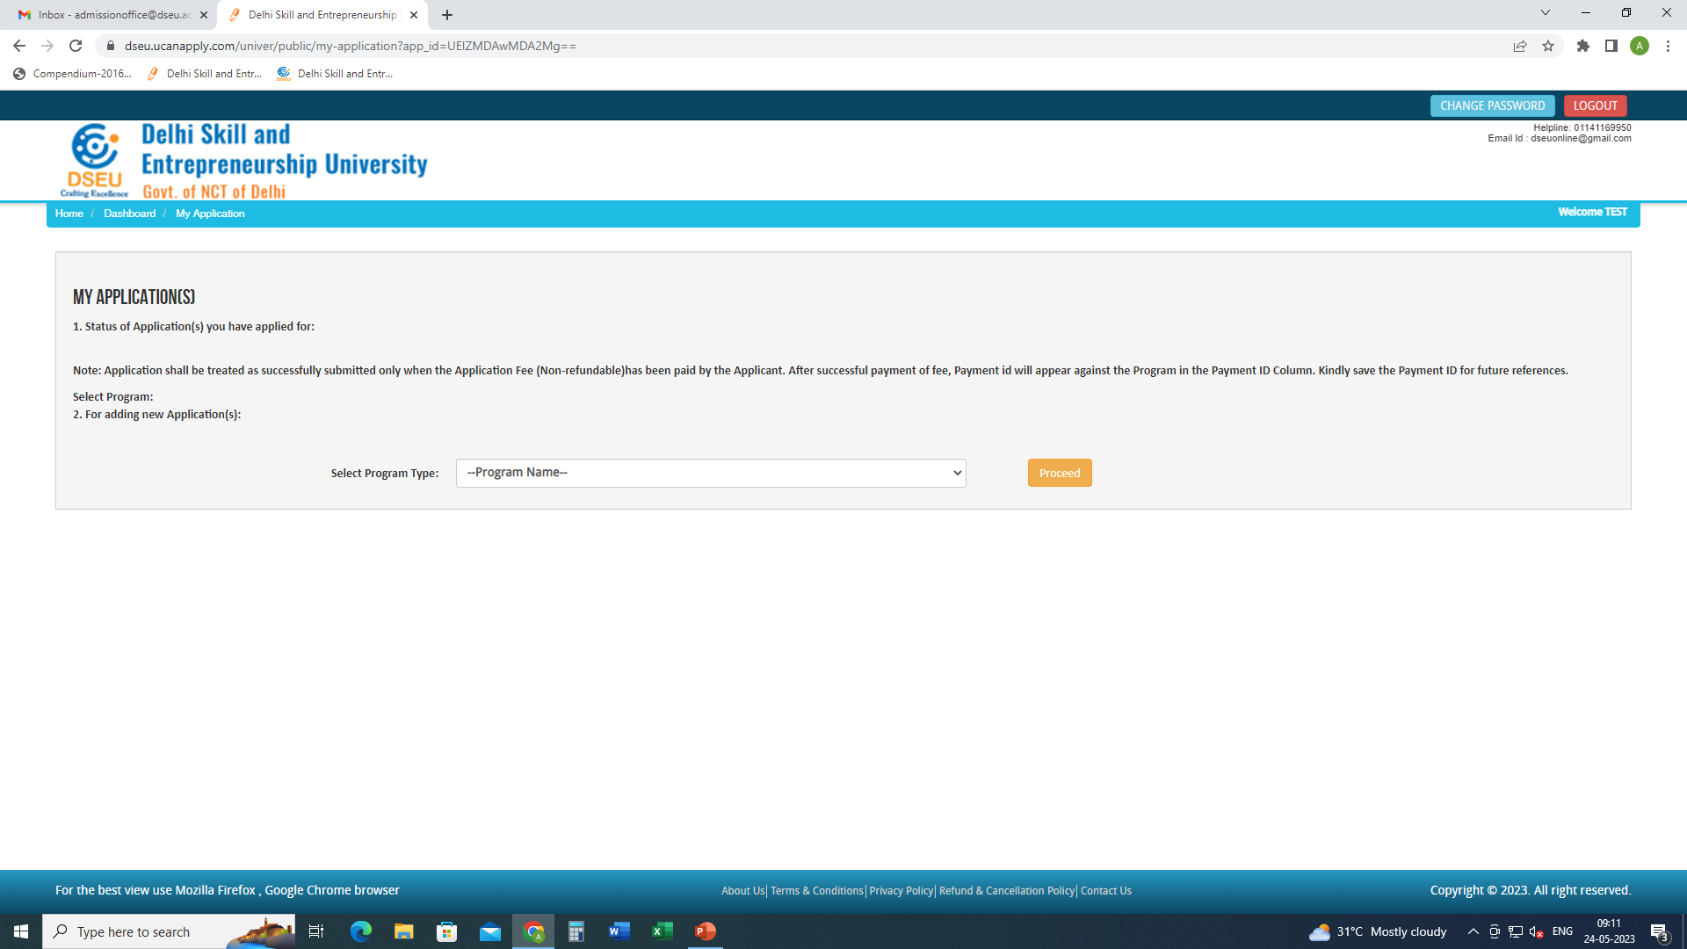
Select Program

Slide 5
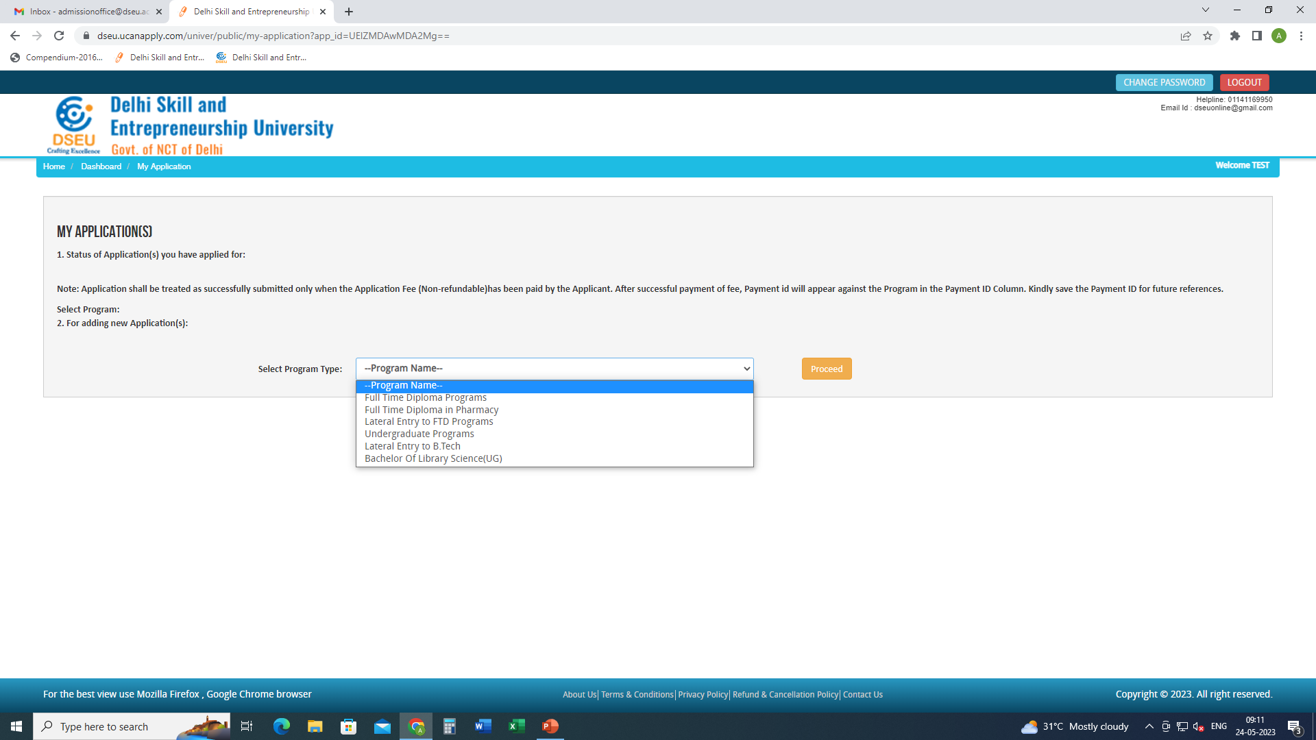

Slide 6
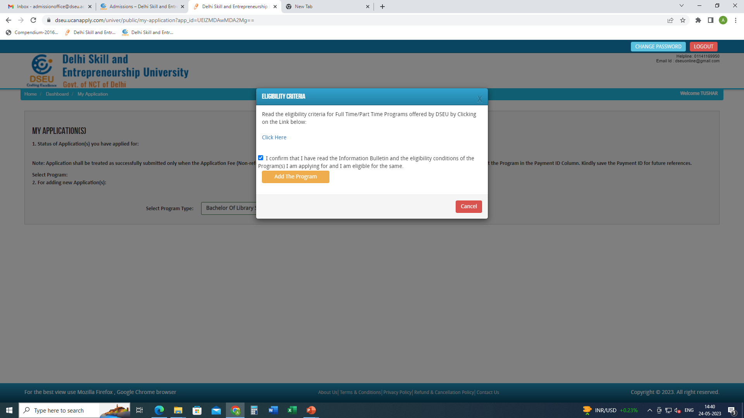
Click to check the eligibility conditions for the program selected.
Check the box
And
Add the program

Slide 7
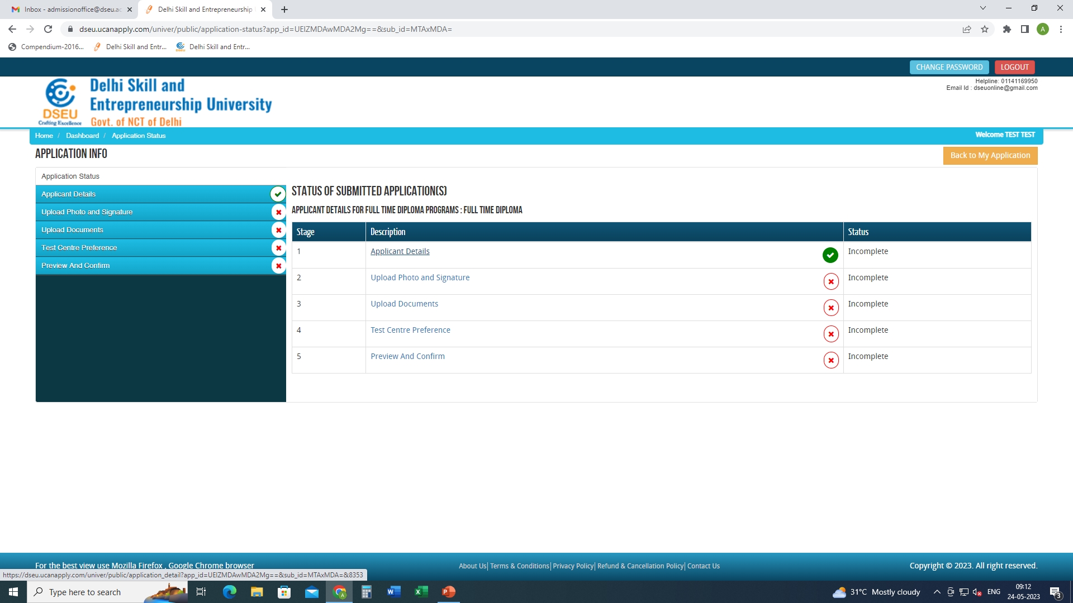
Click applicant details and fill the required information.

Slide 8
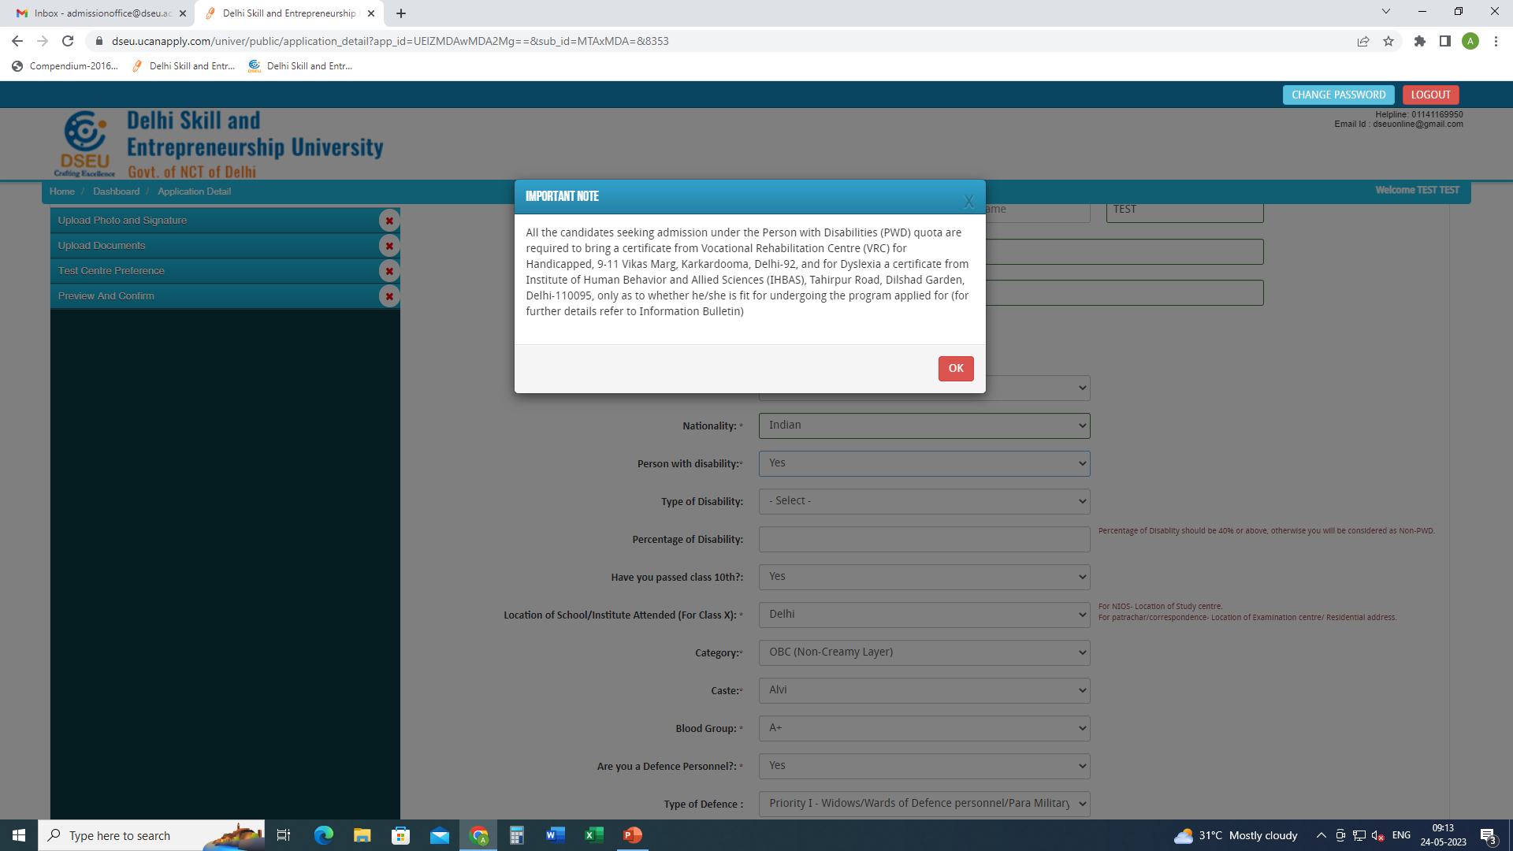
If selected ‘Yes’ in Person with Disability

Slide 9
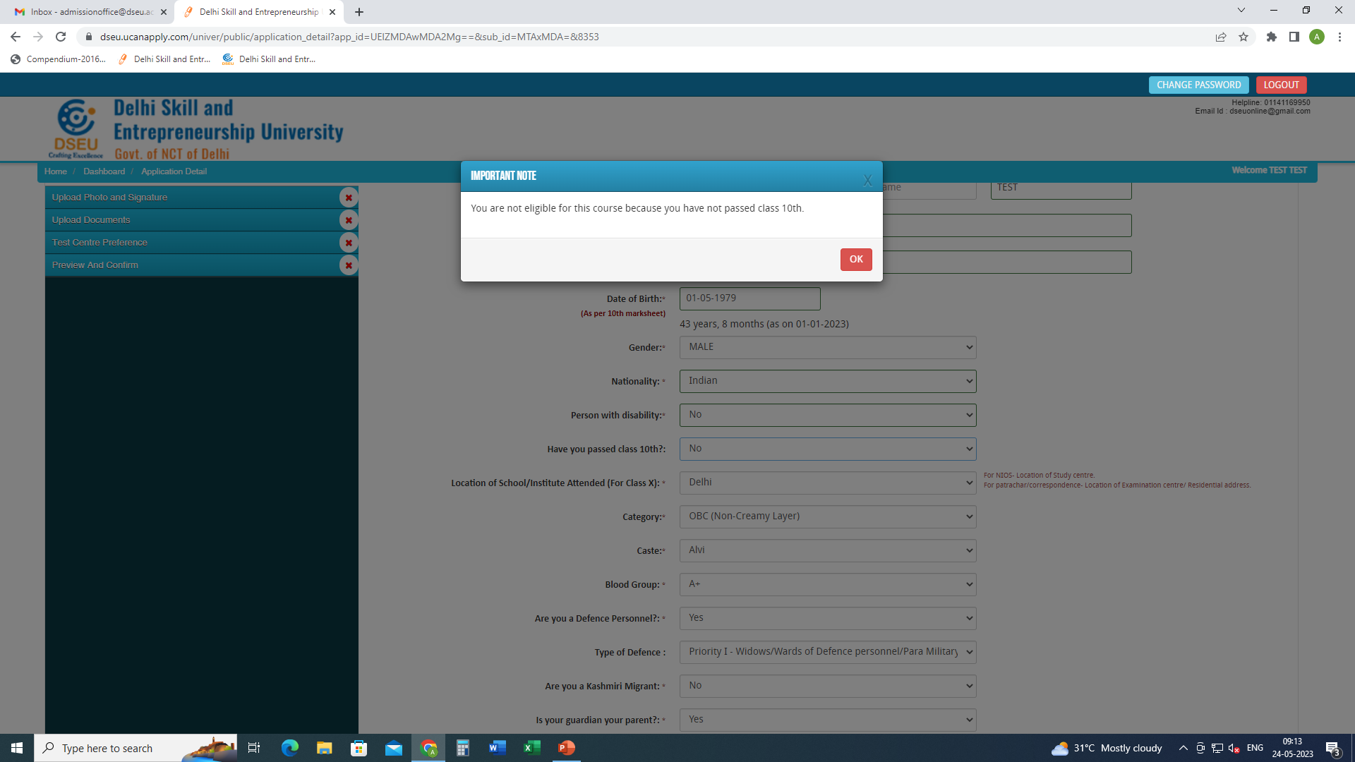
If selected ‘NO’ in Have you passed class 10th

Slide 10
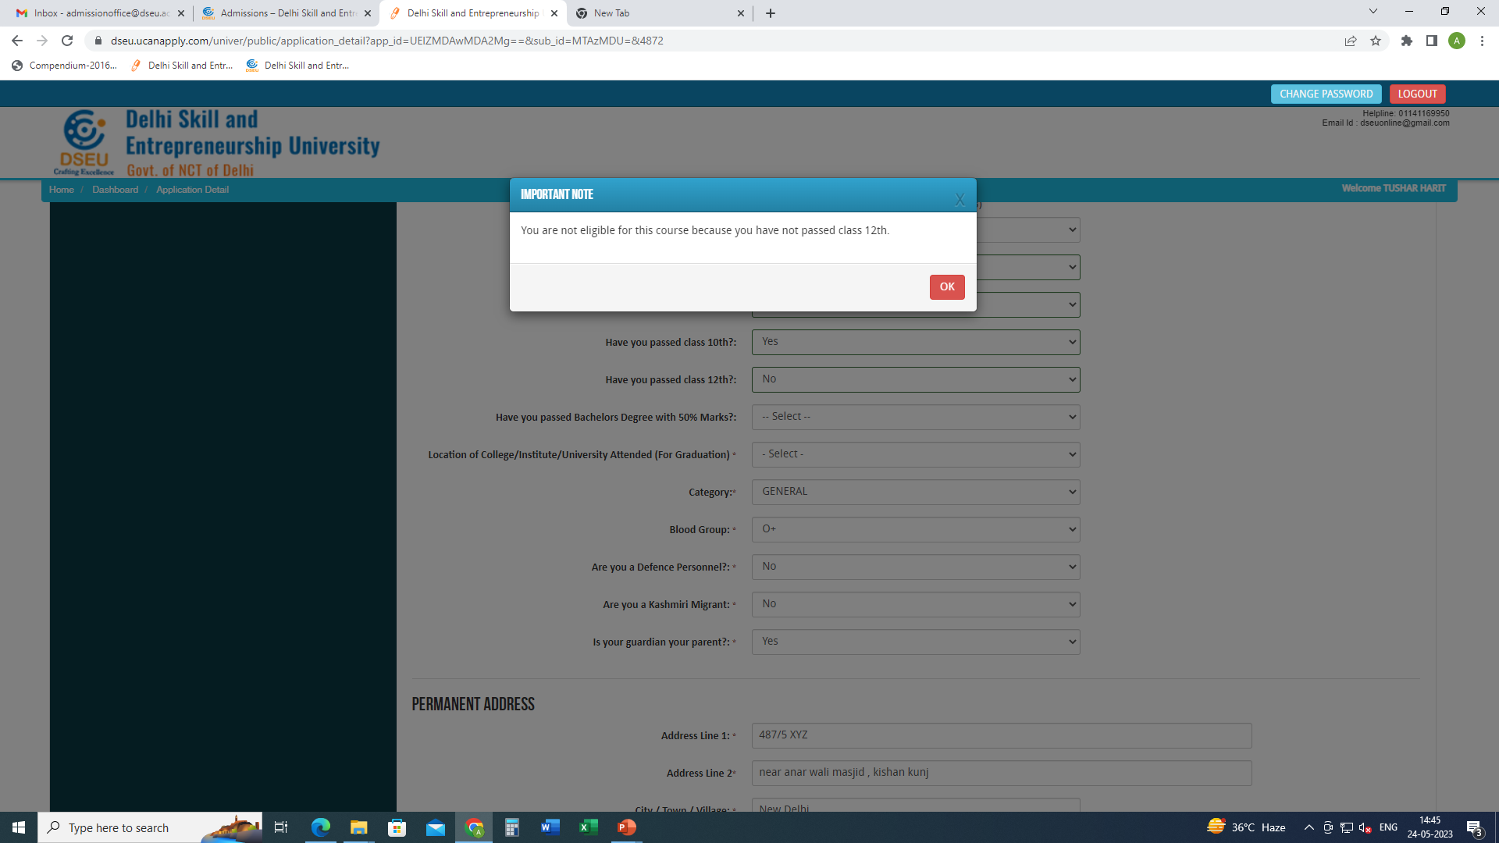
If selected ‘NO’ in Have you passed class 12th

Slide 11
If selected ‘NO’
Fill the location of college/institute/university for graduation
Fill in category

Slide 12
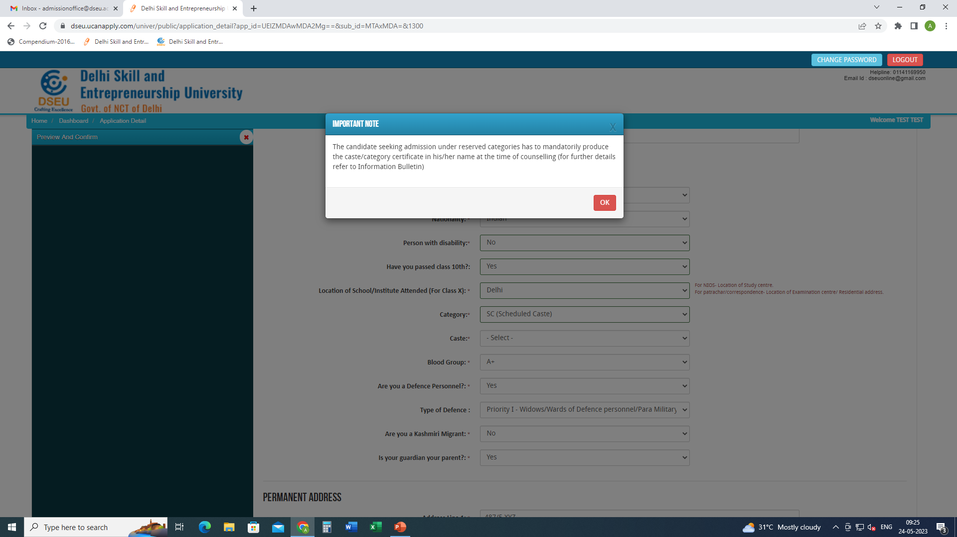
For Delhi SC candidate
Choose caste from the Drop Down

Slide 13
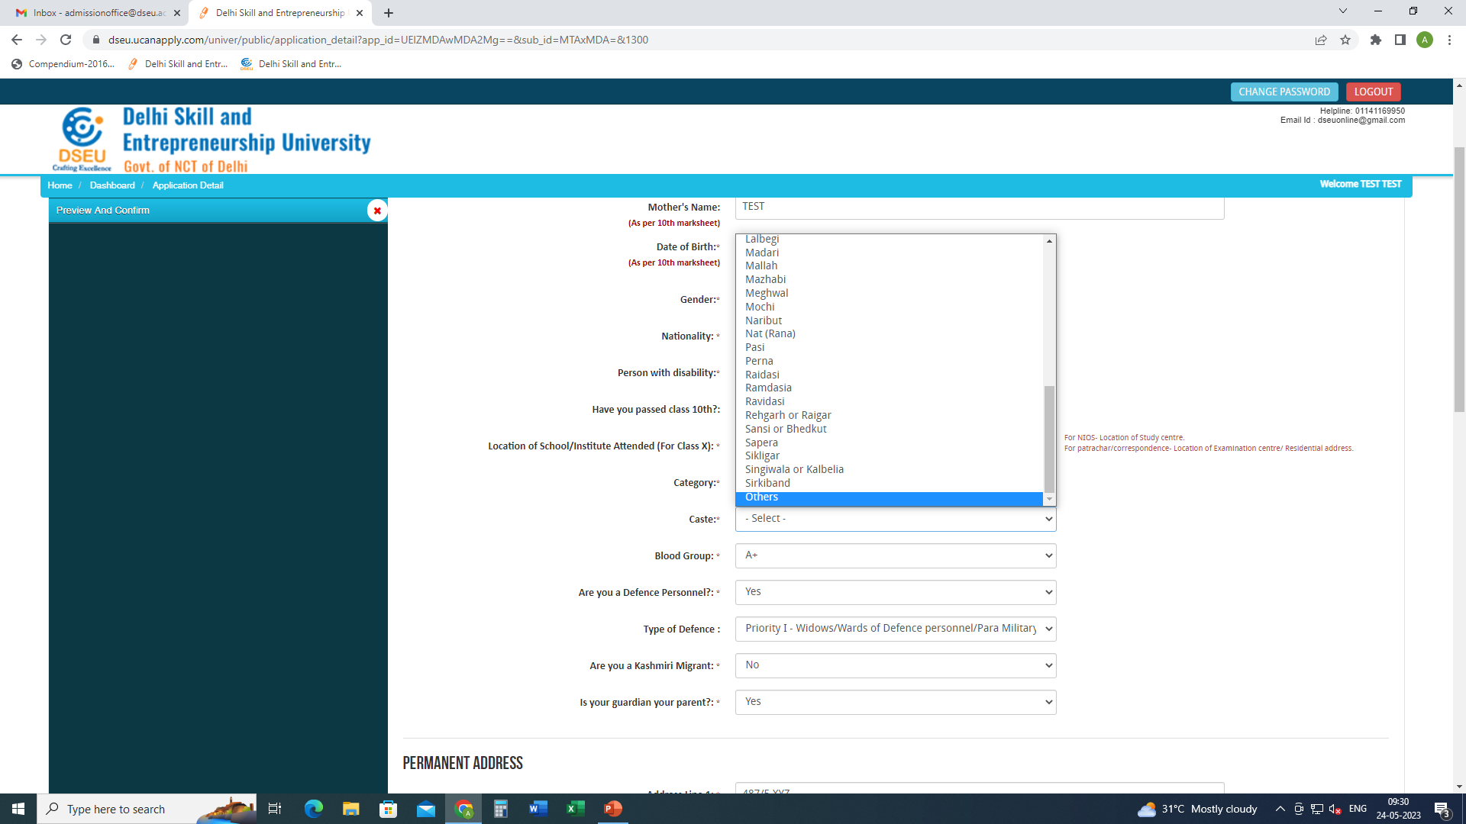
If caste is selected as others

Slide 14
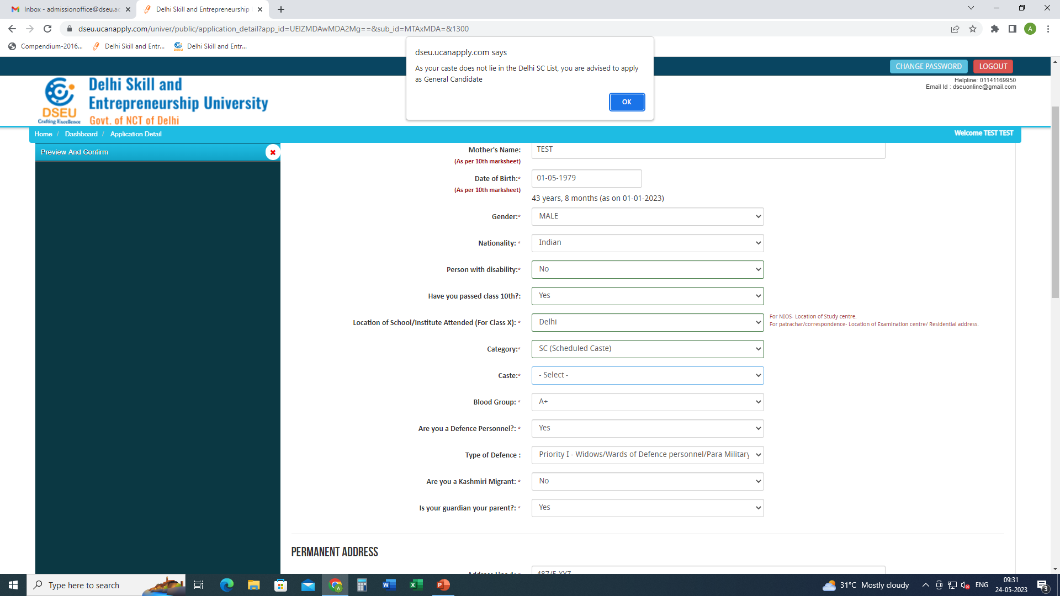
Pop up will ask the candidate to apply as General Candidate

Slide 15
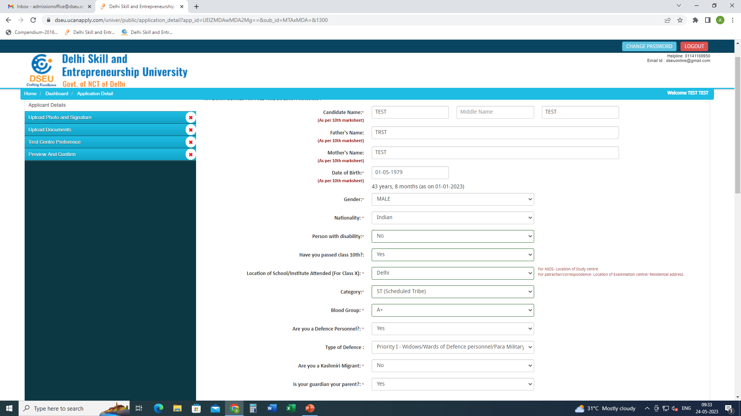
For ST Candidate there will be no pop up and the system will allow him to proceed further.

Slide 16
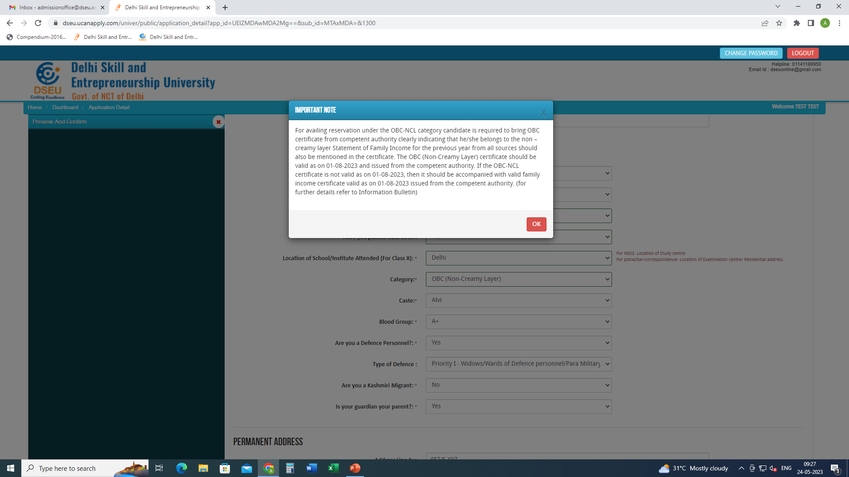
For Delhi- OBC Candidate
Choose caste from the Drop Down

Slide 17
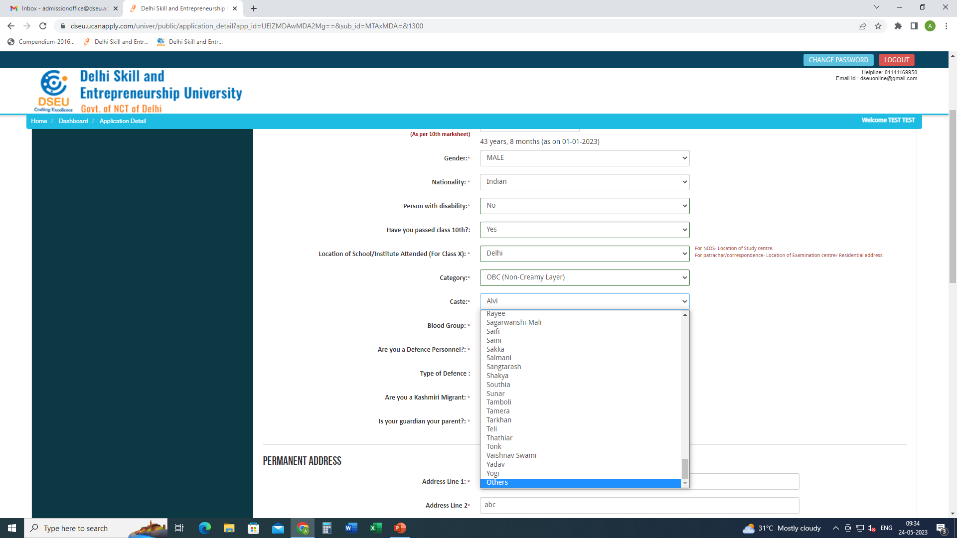
If caste is selected as others then

Slide 18
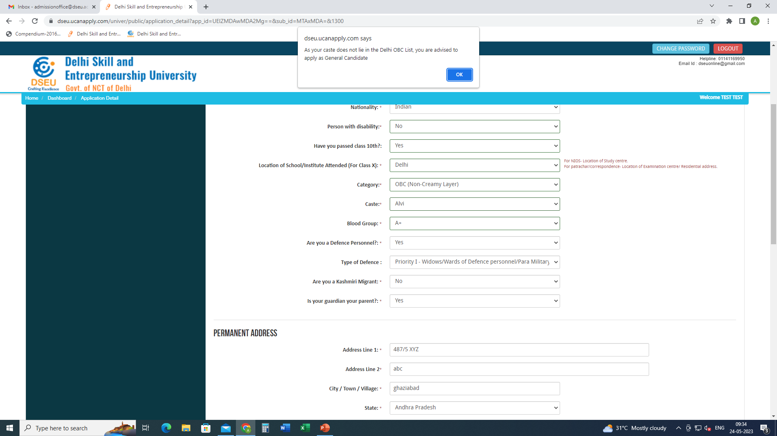
Pop up will ask the candidate to apply as General Candidate
Fill other required information
Then Save and Proceed.

Slide 19
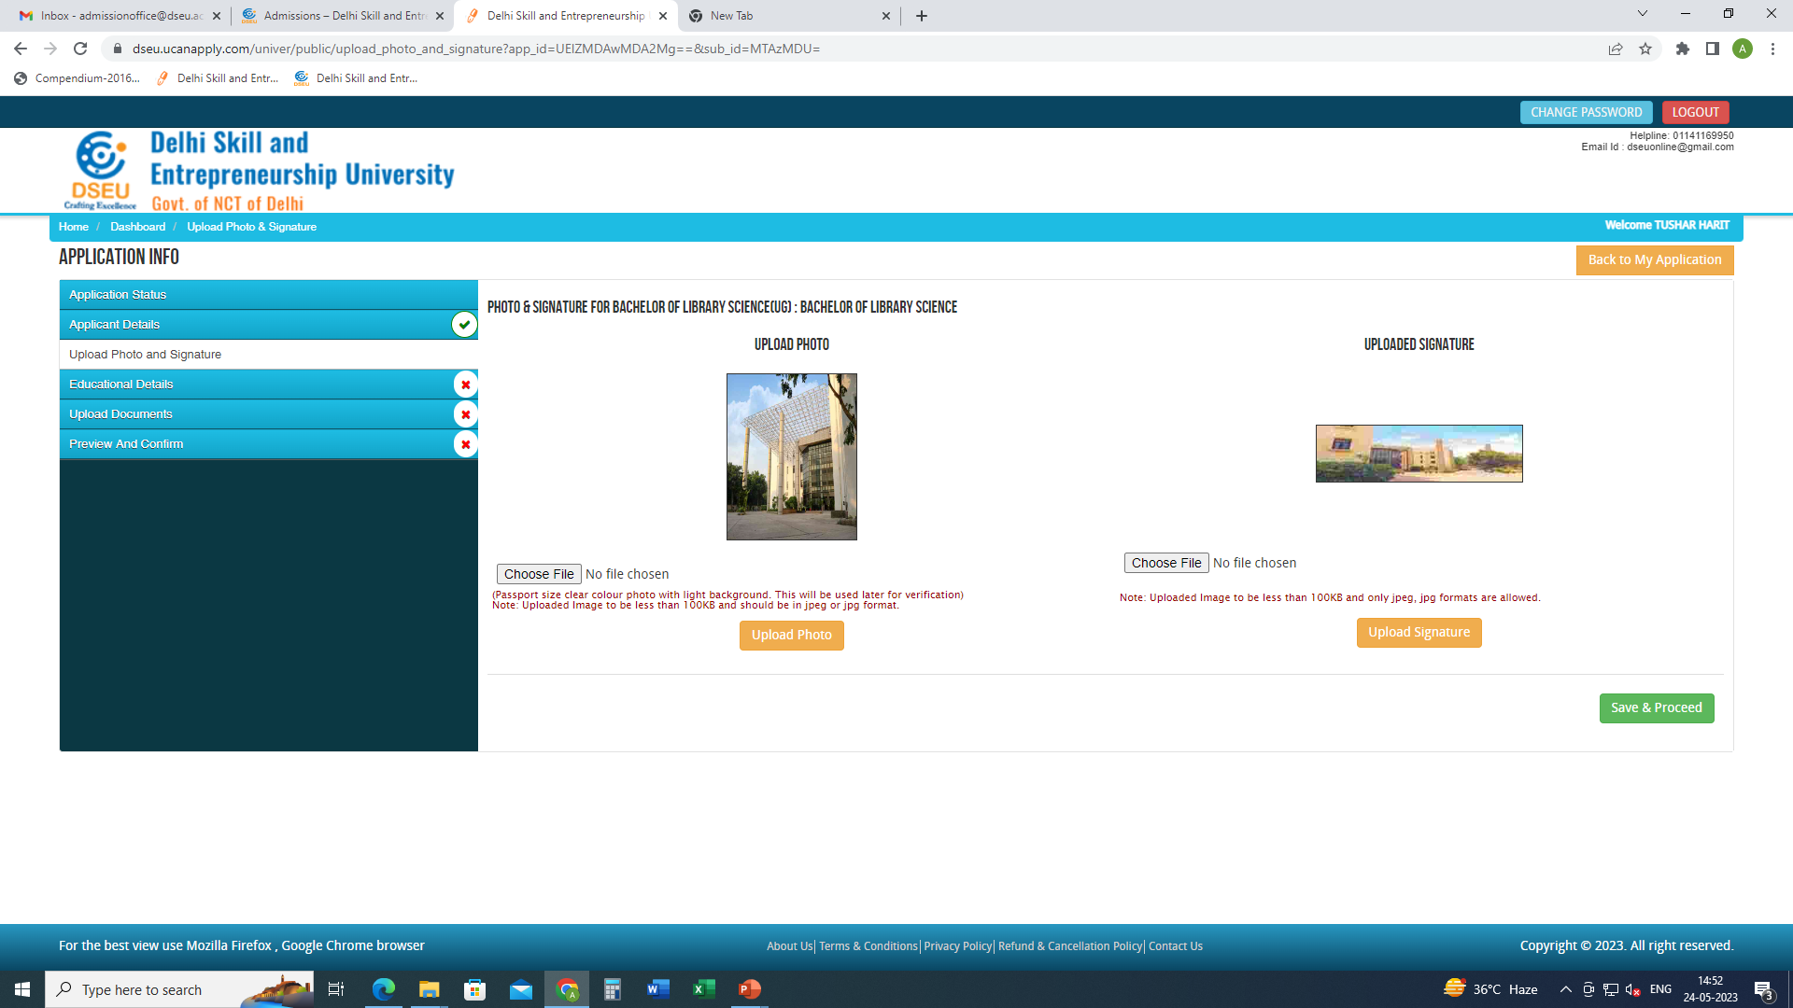
Upload photo and signature
Save and proceed

Slide 20
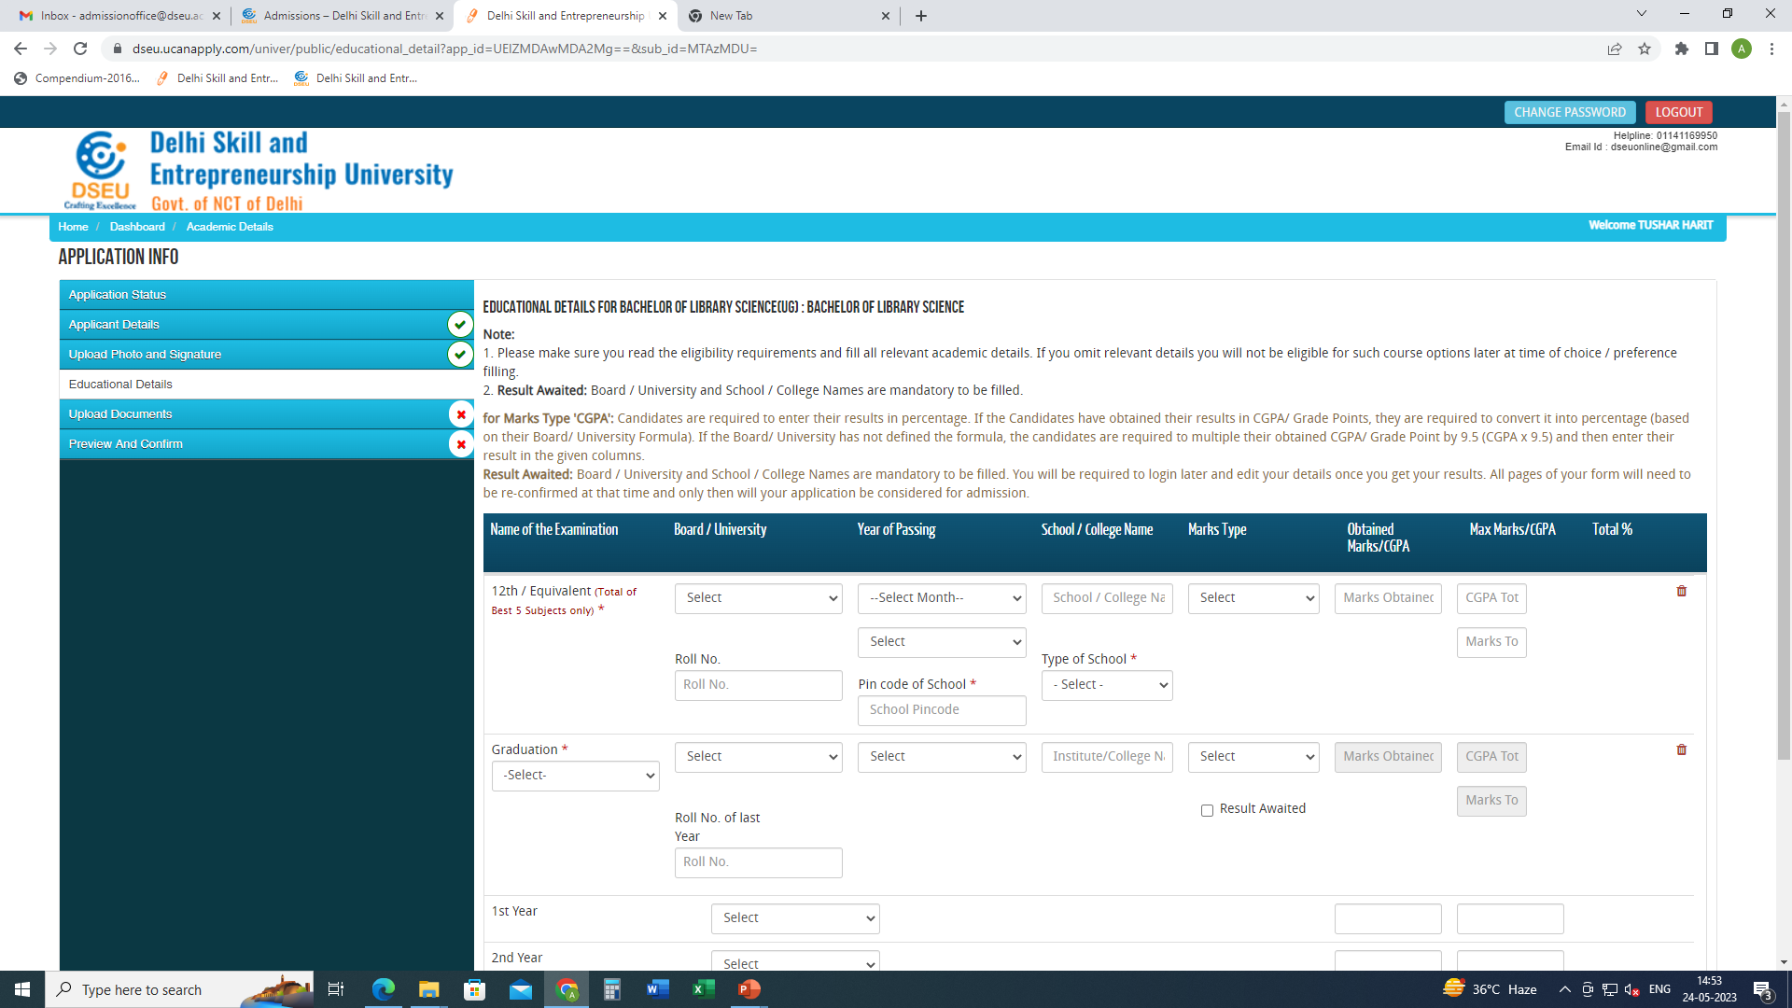
Fill Your educational details
Save and Proceed

Slide 21
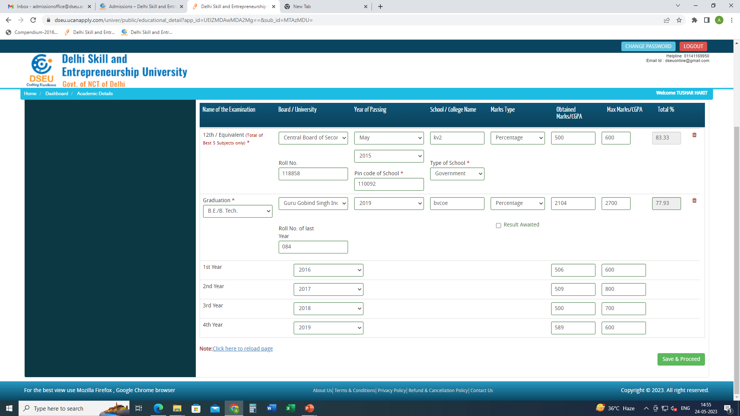
Fill Your educational details
Save and Proceed

Slide 22
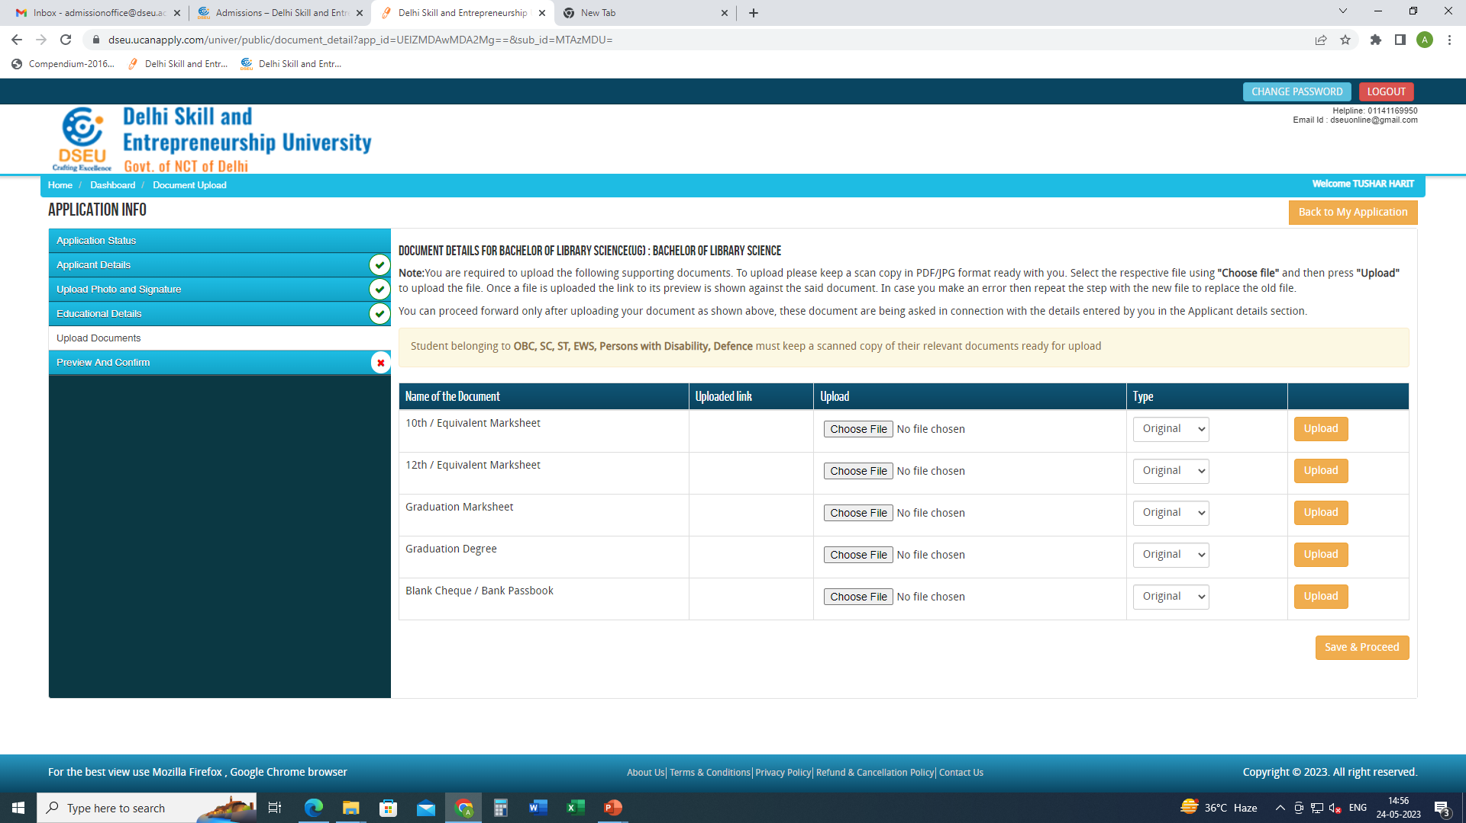
Upload the required documents
Save and Proceed

Slide 23
preview and confirm( check details carefully) -pay registration fee -print final application form for future reference.

